Slide 1
Subsidiary ICT for Uganda
Curriculum Topic 3 out of 15: COMPUTER LABORATORY CARE AND MAINTENANCE
Recommended Coverage Duration: 16 periods (2²/₃ weeks)
Senior Five Term I
Notes:
Guidance to the Teacher
Provide some few computers where the learner can practise how to install and uninstall software on computer systems. This should be done for both application software and system software.
Guide the learner to identify and correct simple practical problems encountered when using a computer. For example, simple troubleshooting software failures, boot failure, identifying loose power connection and many more.
Where the word lab or laboratory has been used, it is exclusively referring to the computer laboratory. Suggested Competences for Assessment
Assess the learners’ ability to install application and system software; take care of a computer system and use it safely.

Slide 2
Background
The use of ICTs has a number of challenges for example, computers malfunction, laptops break down, servers go offline, networks become unavailable and computers slowdown with time, etc. All of these problems can be minimised by keeping up with regularly scheduled preventive maintenance activities.
It is important for every user to have an idea on basic preventive maintenance in order to maintain the equipment in a good running condition. This topic will equip the learner with skills to maintain his/her computer systems in a good running condition and the safety measures to observe when working in a computer laboratory.
Learning Outcomes: The learner should be able to: take care of computer systems, maintain (service) computer systems, troubleshoot malfunctioning computer systems and restore them to a good running condition.

Slide 3
Presentation Outline
UACE Sub – ICT Topic 3:
Introduction to Computing
Sub Topic 3.1: Computer Literacy
Sub Topic 3.2: Secure Laboratory Environment
Sub Topic 3.3: Servicing and Maintenance of Computer Systems

Slide 4
Sub Topic 3.1: Computer Literacy
Sub topic Objectives:
3.1.1 Describing the booting process of a computer system.
3.1.2 Explaining the meaning of computer literacy.
3.1.3 System Startup.
3.1.4 Opening application programs.

Slide 5
3.1.1 Booting process of a computer system
Booting is the process of starting or restarting a computer.
Booting is a series of operations that start and set a computer for use.
To care for computers and maintain them in good working conditions, users have to be conscious of the booting process as outlined in the previous topic on computer management.
For example, improper shutdown of the computer can cause it to fail to boot successfully next time it is switched on.

Slide 6
3.1.2 Explaining the meaning of computer literacy
Computer literacy is the ability to use computers and related technology efficiently.
It’s the level of familiarity with the basic ICT concepts that allows one to easily use personal computers.
To be considered computer literate, one needs to possess skills such as
turning on the computer and log in, opening and creating folders and files,
Word processing,
Spreadsheets skills,
Browser basics (Internet and Email),
Basic hardware terminology,
Virus and security awareness.

Slide 7
Advantages of Computer Literacy
Profitable Skills: The ability to use programs such as Word Processors can aid one to make money or get hired for a higher-level job when other candidates do not have the skills.
Leadership and Promotions: Computer literacy skills may get one promoted to a higher position within your workplace or be put in a leadership position in which you teach others how to use computers or certain computer programs.
Work Performance: Knowing how to use a computer often allows you to get work done in a more organized, efficient and timely manner
Communication: Knowledge of how to access the Internet on a computer opens up different possibilities for you to communicate with coworkers or supervisors.
Being prepared For the Future; Computer technology is advancing faster, so if you are familiar well with computer skills now this will makes you ready for bright future.

Slide 8
Advantages of Computer Literacy
Ability to use New Media; traditional media like newspapers and television are being replaced by computer based media such as social media, and online blogs which require computer literacy skills to use.
More job opportunities; since almost all workplaces use computers, the need for people having computer skills is really in great demand.
NB: Digital divide is the inequality with regard to access to information and communication technologies (ICT).
It is the lack of opportunities experienced by those with limited accessibility to technology, especially the Internet.
Is can be a result of having some societies one with very high levels of computer literacy and others lagging far behind.

Slide 9

Advantages of Computer Literacy
Map showing global distribution of computers per 100 people. An illustration of digital divide at the country level.

Slide 10
3.1.3 System Startup
On start up, the OS may verify that the person attempting to use the computer is a legitimate user through use of a password.
After the user logs on, the desktop and icons are displayed on the screen.
Finally, the operating system also executes programs in the Startup folder, which contains a list of programs that open automatically when you boot the computer.
Microsoft Windows users can see each of the programs that startup each time their computer boots by using the msconfig utility.

Slide 11
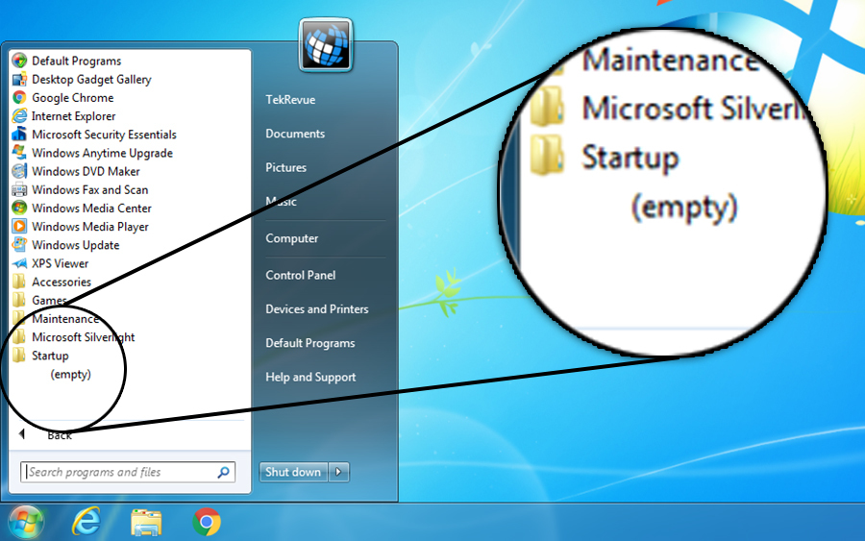
The Startup Folder
The Startup folder on Windows OS contains a list of shortcuts of those applications that start when Windows starts.
On Windows 7, you could easily access the startup folder from Start Menu > Startup.

Slide 12
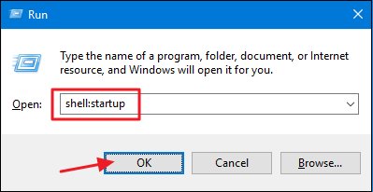
The Startup Folder
To open the “Startup” folder the easy way, just hit Windows+R to open the “Run” box, type “shell:startup,” and then press Enter.
To manage all startup programs (even those not listed in the startup folder), you can launch the msconfig by hitting Windows+R to open the “Run” box, and typing the “msconfig” command.

Slide 13
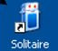
3.1.4 Opening application programs
An application is defined as a computer program designed to help people perform a certain type of work. Examples of applications include word processing programs, spreadsheets, media players, and even games.
You can open, or launch, a program by using any of the following methods:
Double-click a program shortcut icon on the desktop.
Click an item on the taskbar.
Choose Start→All Programs. Click the program name on the All Programs list that appears.
You can use the Start menu’s search feature to launch a program.

Slide 14
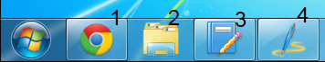
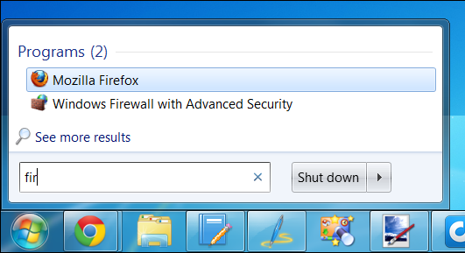
3.1.4 Opening application programs
On Windows 7, you can press the Windows key along with a number to quickly launch the corresponding application on your taskbar.
For example, WinKey+1 launches the first application pinned to your taskbar.
You can use the Start menu’s search feature to launch a program with just a few key presses.

Slide 15
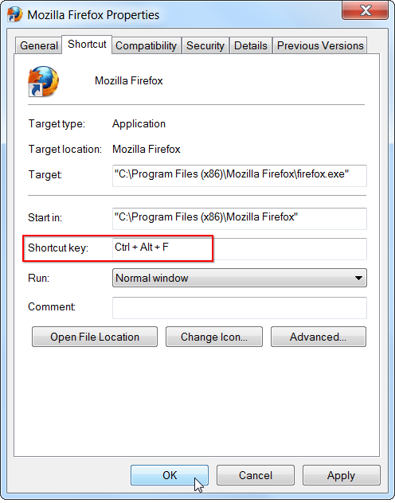
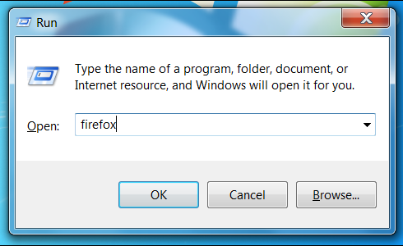
3.1.4 Opening application programs
If you launch an application frequently, you can assign a custom keyboard shortcut to it. First, locate the application in your start menu or on your desktop, right-click its shortcut, and select Properties.
You can also use the Run dialog to quickly launch applications. Open it by pressing WinKey+R.
In the Run dialog, type the name of a program’s .exe file and press Enter to launch it.

Slide 16
Sub Topic 3.2: Secure Laboratory Environment
Sub topic Objectives:
3.2.1 identifying areas of laboratory security.
- physical security
- electric power security
- security cameras
- first aid boxes
- fire extinguisher
- air conditioning, etc.
3.2.2 Safe use of the computer laboratory.
3.2.3 preparing laboratory rules and regulations

Slide 17
The Computer Laboratory
A computer laboratory is a room that is specially designed and prepared to provide a safe and conducive environment for using computer systems.

Slide 18
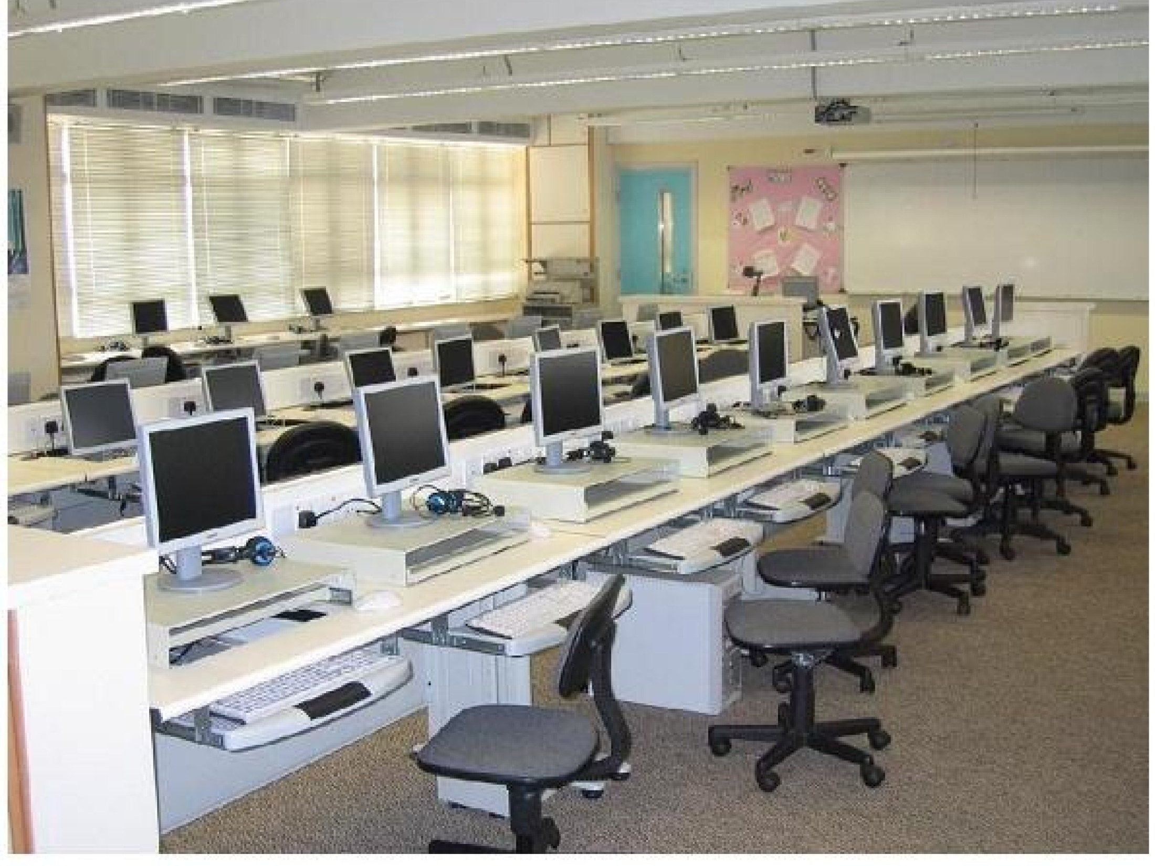

Slide 19
Factors to consider when setting up a computer laboratory
Security of computers, programs and other resources from theft
Reliability and stability of the power source
The number of computers to be installed and the available floor space
The maximum number of users that the computer laboratory can accommodate
Safety of users: eye strains, emissions and back problems control
Temperature ranges in the area and Humidity in the atmosphere
Amount of dust in the environment
Protection against Lightening and Fire outbreaks

Slide 20
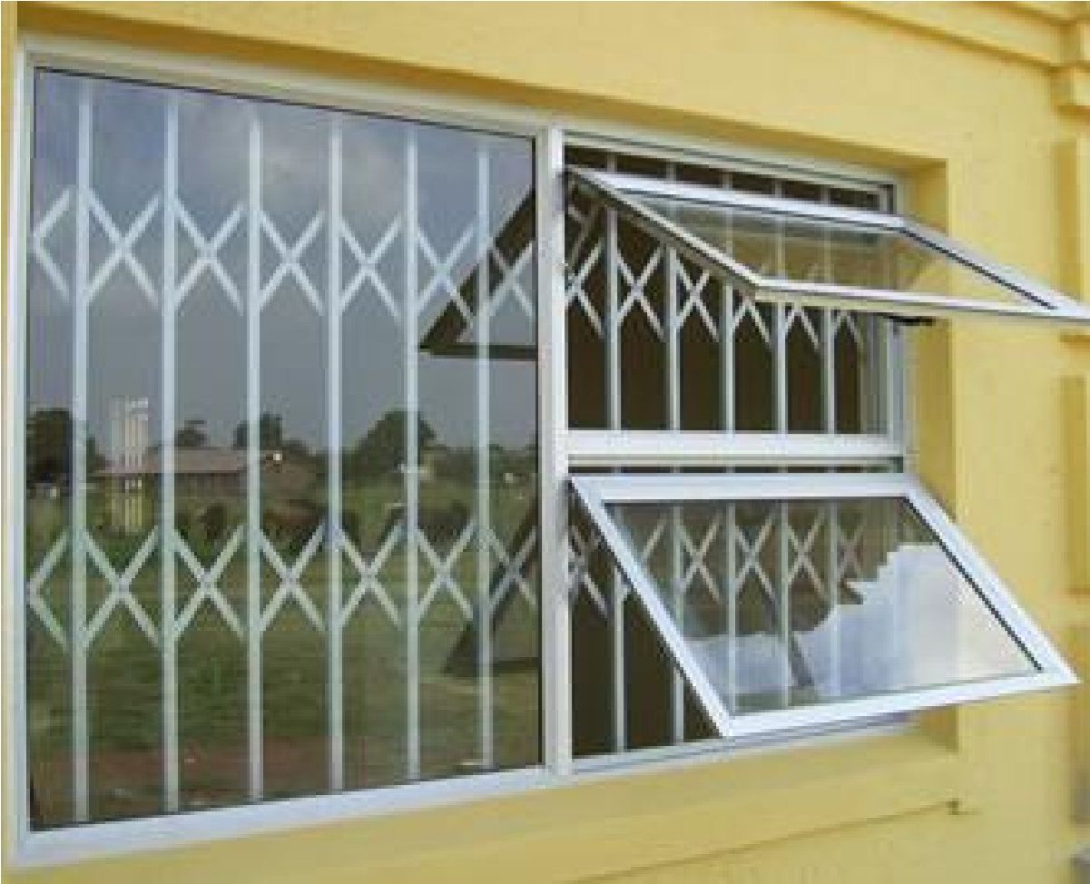

3.2.1 Areas of laboratory security
Organizations, libraries, and schools running public computer labs face a variety of complex computer security challenges. These institutions take measures to ensure the safety of the equipment, software, data and users.
(a) Physical security measures
Burglar proofing avoid unauthorized access to computer room.
Fit strong locks, doors, windows and roofing. Security should be good around computer room to avoid thefts.
26

Slide 21
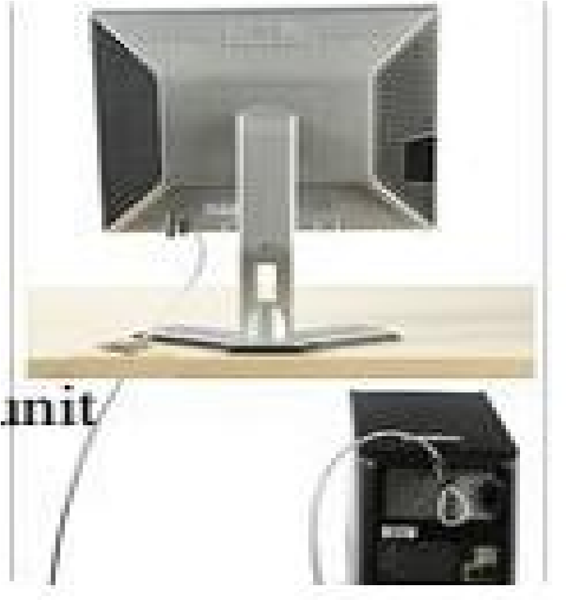
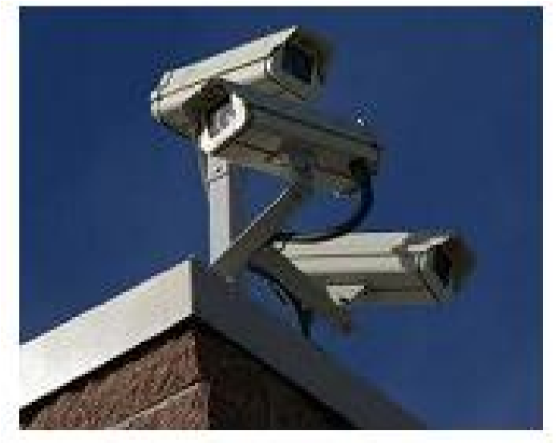
Physical security
Employ security guards to keep watch over data and information centers.
Apply burglar proof for the computer laboratory by reinforcing weak access points like windows, doors, roofing with metal grills and strong padlocks.
Set up alarms to alert you in case of break-ins.
Use system locks (locked key systems) to make it difficult to access internal components like hard disks and memory sticks.
Use cables to lock the equipment to desk, cabinet or floor.
Electronic locking mechanism with keys, swipe cards, finger print recognition.
CCTV Cameras to keep watch over computer systems and centers.

Slide 22
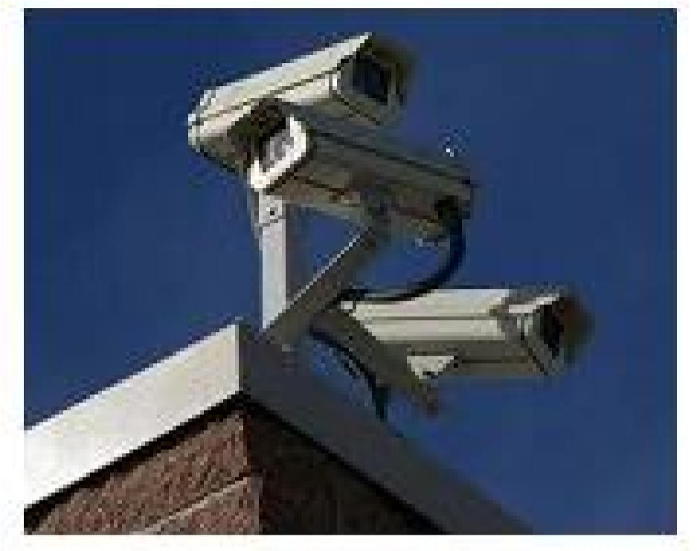
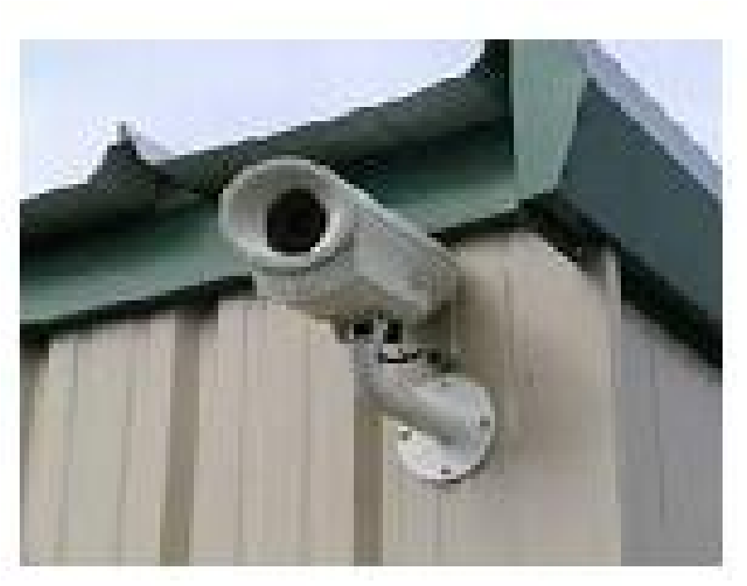
Security camera
Security cameras act as a deterrent to theft and other crimes in computer labs and data centers.
Closed Circuit TeleVision (CCTV) surveillance cameras are used to record video which can be viewed in the monitoring room and played back in case of any investigations.
CCTV cameras
.

Slide 23
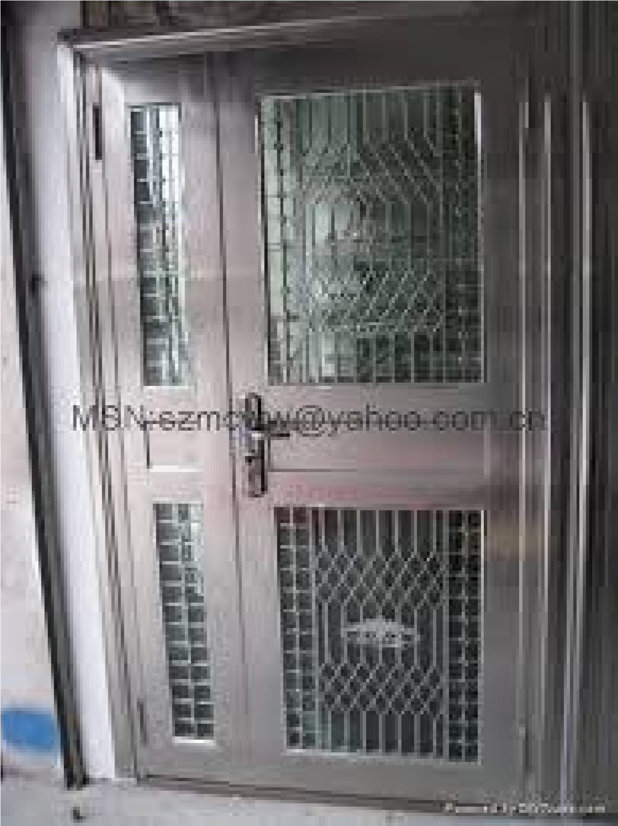
Burglar proofing
Burglar proofing provides protection against any forced physical entry into the computer laboratory.
Burglar proofing involves fitting metal grills in windows and doors.

Slide 24
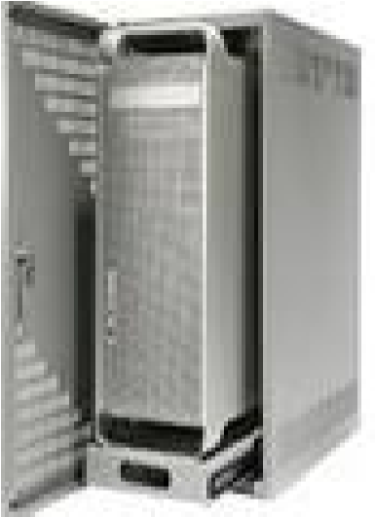
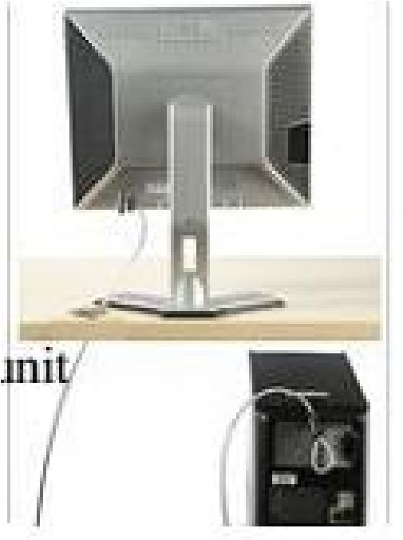
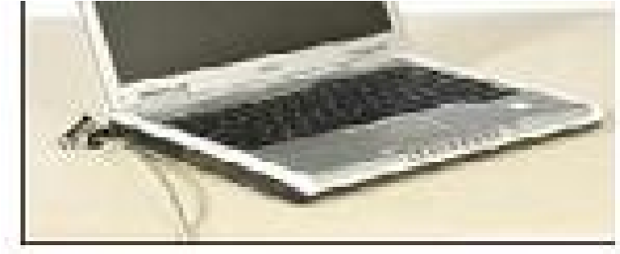
Burglar proofing
Consider installing security alarms at strategic access points that would alert the security personnel in case of a break-in.
Fit strong metallic grills and locks on doors, windows and strengthen the roof incase the roofing is weak.
Use Desktop locks, system unit enclosures and laptop locks.

Slide 25
Electric power security
Electric power security: Place no more than two computers on each circuit. Do safe well insulated cabling.
Keep the circuits for computer systems separate from all other equipment such as printers, copiers and coffee makers.
Plug each computer into a surge protector or UPS (Un interruptible Power Supply Unit).

Slide 26
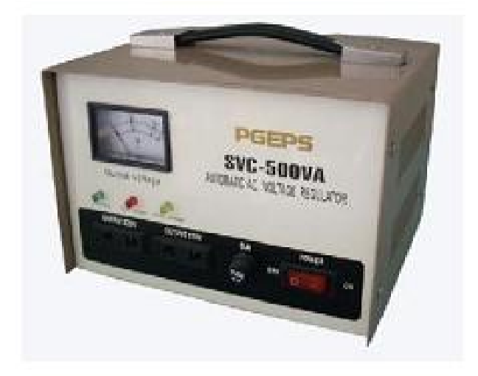
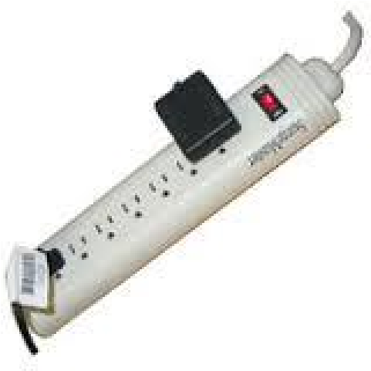
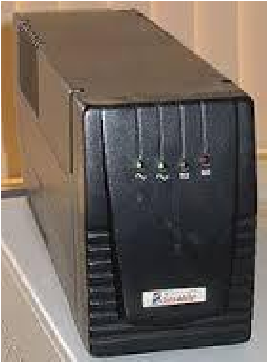
Electric power security
Stable power supply
Protect computers from being damaged and data loss due to power instabilities by having:
Power stabilizers maintain power at required voltages.
A surge protector can be used to protect computer equipment against under voltage and over voltage.

Slide 27
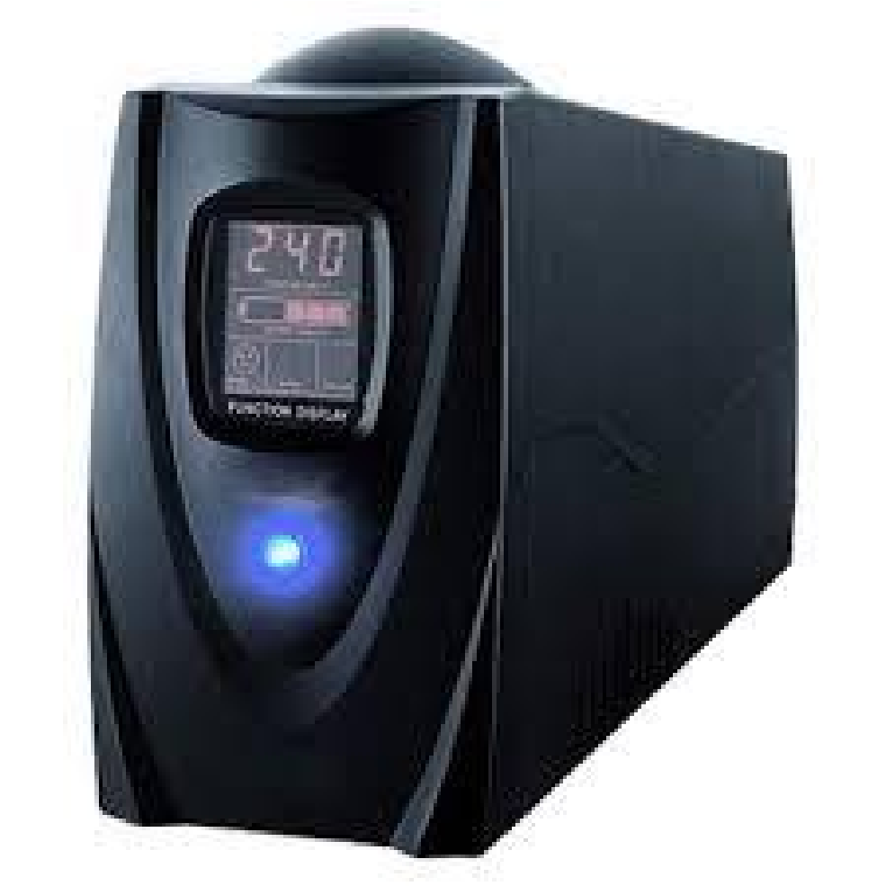
Electric power security
UPS- Uninterruptible Power Supply
Computers need the time to shut down properly. Damage to devices and data can occur when there is sudden power loss or fluctuation.
UPS, or Uninterruptible Power Supply units, keep backup power for devices in the event of a failure or other electrical problems.
A UPS is essentially a small battery that keeps the power supply on for long enough for you to switch off the computer safely when there is a sudden blackout.

Slide 28
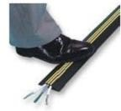
Electric power security
Cable insulation: All power cables must be properly insulated and laid away from pathways in the room.
Lay them along the walls in trunks. This prevents electric shock and power disconnections caused by stumbling on cables.
Always install lightening conductors to the computer laboratory to protect the machines and the users of the computers.

Slide 29

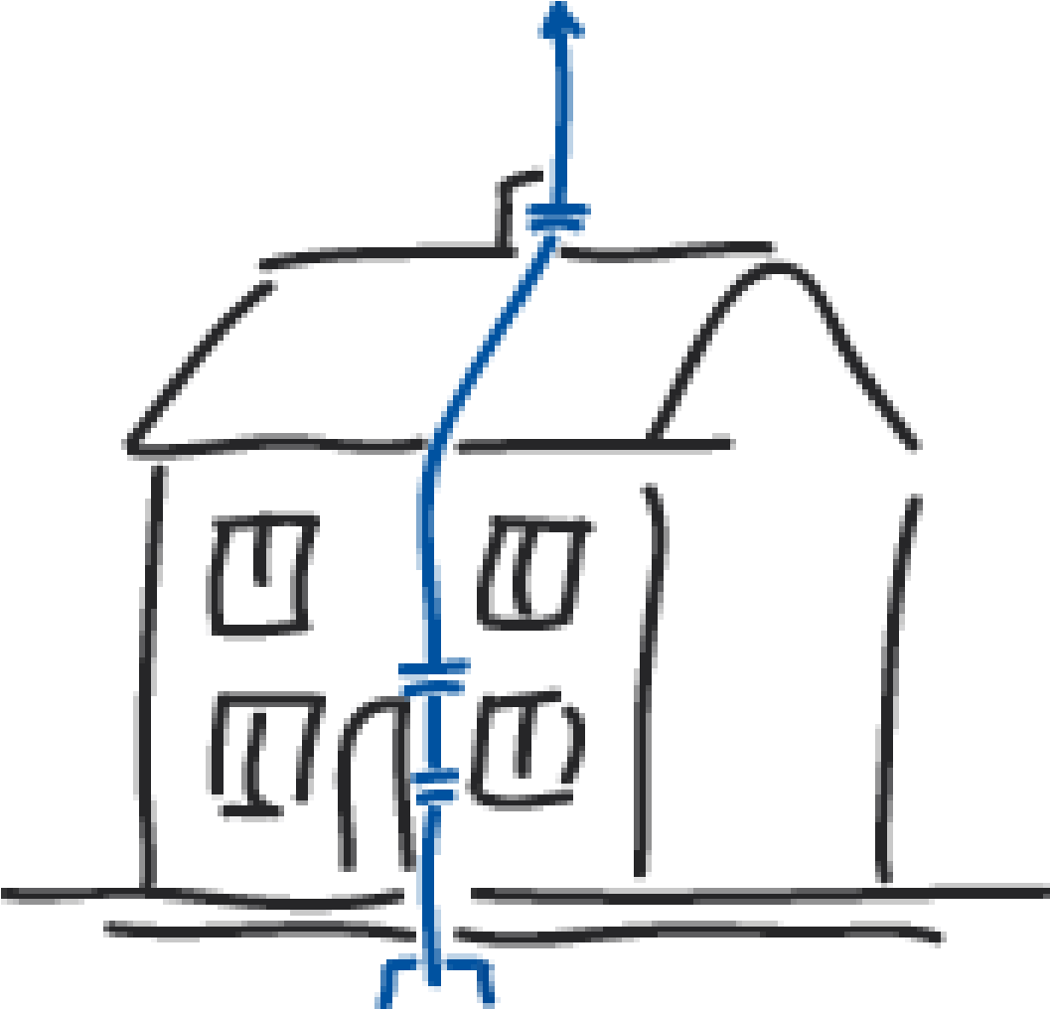
Electric power security
Always install lightening conductors to the computer laboratory to protect the machines and the users of the computers.
Minimize Electrical noise / interferences in the computer environment. ELECTRICAL NOISE refers to externally radiated signals that cause undesirable additions to the current voltage.

Slide 30
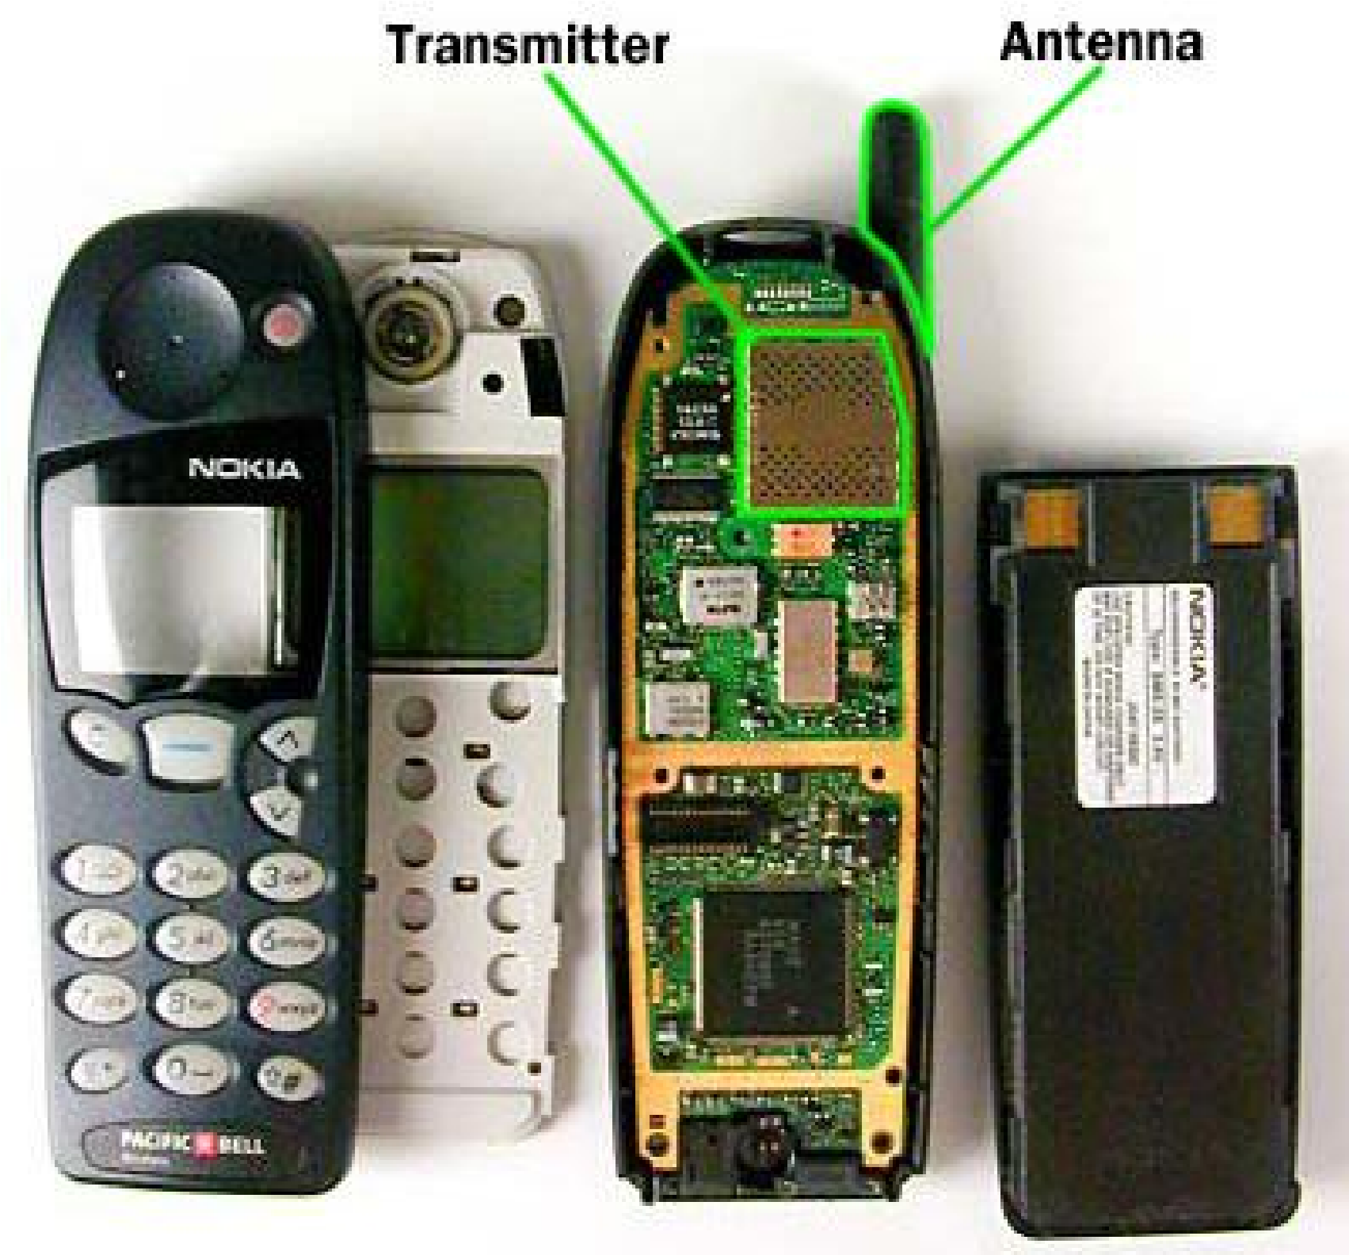
Electric power security
Electrical noise is commonly generated by devices like Fluorescent lights of high frequency, Motors, Battery
Chargers, Inverters, Radios, television, and Cell phones.

Slide 31
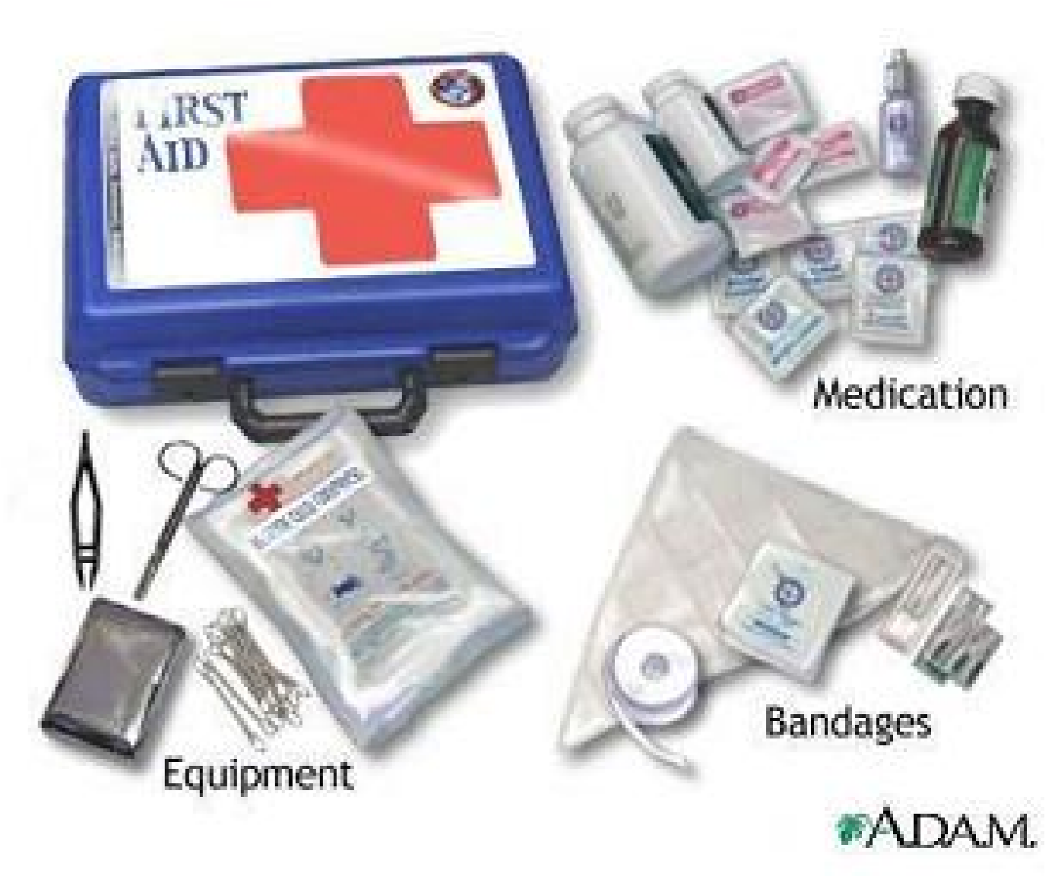
First aid kits and Toolkits
First aid box: A first aid kit is a box or bag that contains the necessary items for providing care in case of any emergency in the computer lab such as a electric shocks.
Tool kits are also necessary for keeping ICT repair and maintainace tools

Slide 32

Fire extinguisher
Fire extinguishers are a critical component of saving property and lives in the case of a fire emergency.
Owning a fire extinguisher is a form of ensuring safety.
All computer rooms need it just in case a fire starts.
It can save our property from burning because the use of the device will help prevent it from spreading and can even stop the flame in no time.

Slide 33
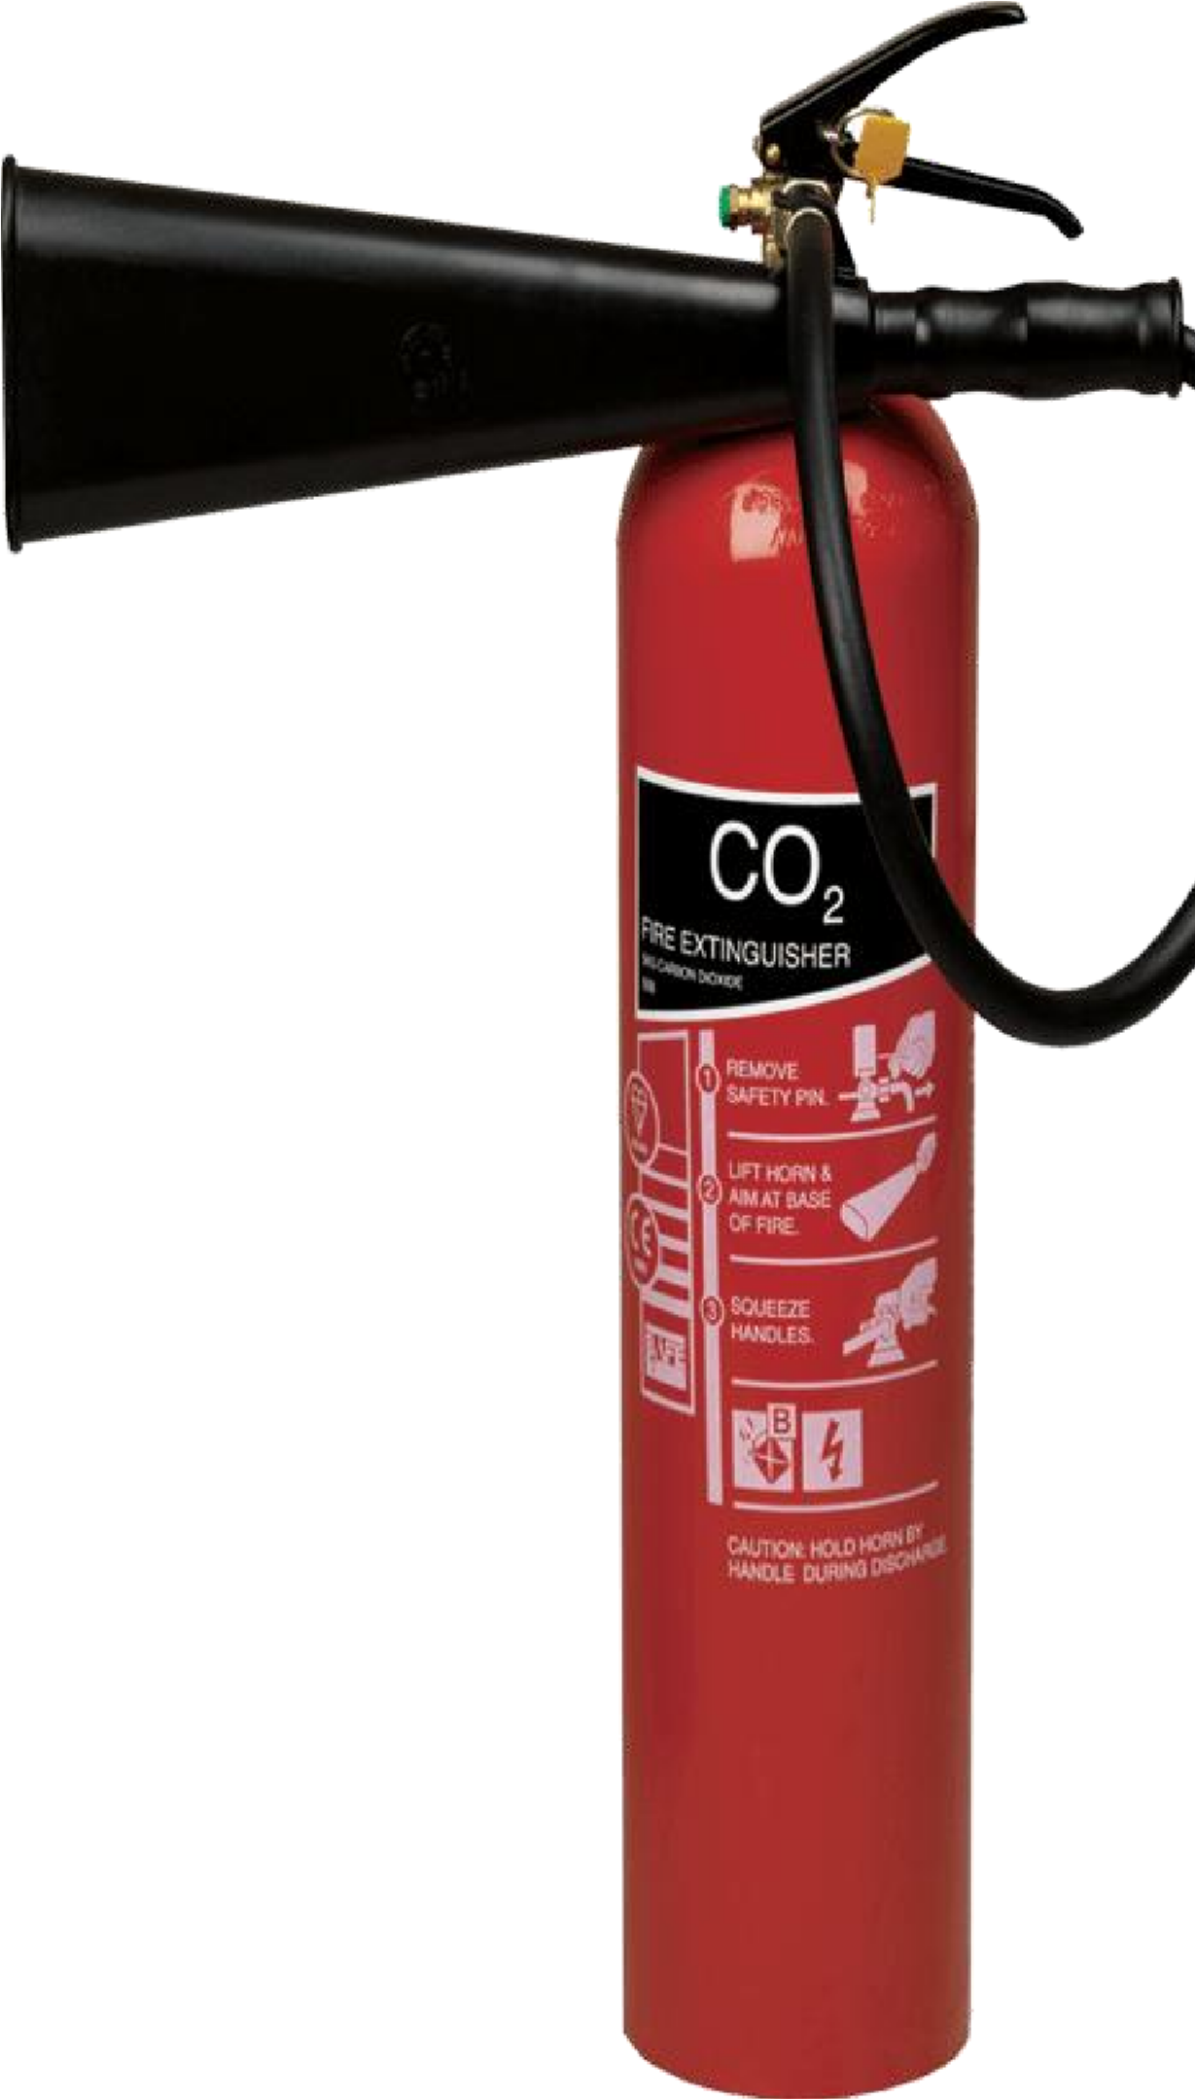
Fire extinguisher
Have gaseous fire extinguishers like those filled with carbon dioxide. Water based or powder extinguishers should be avoided since they can cause damage to computer components.

Slide 34
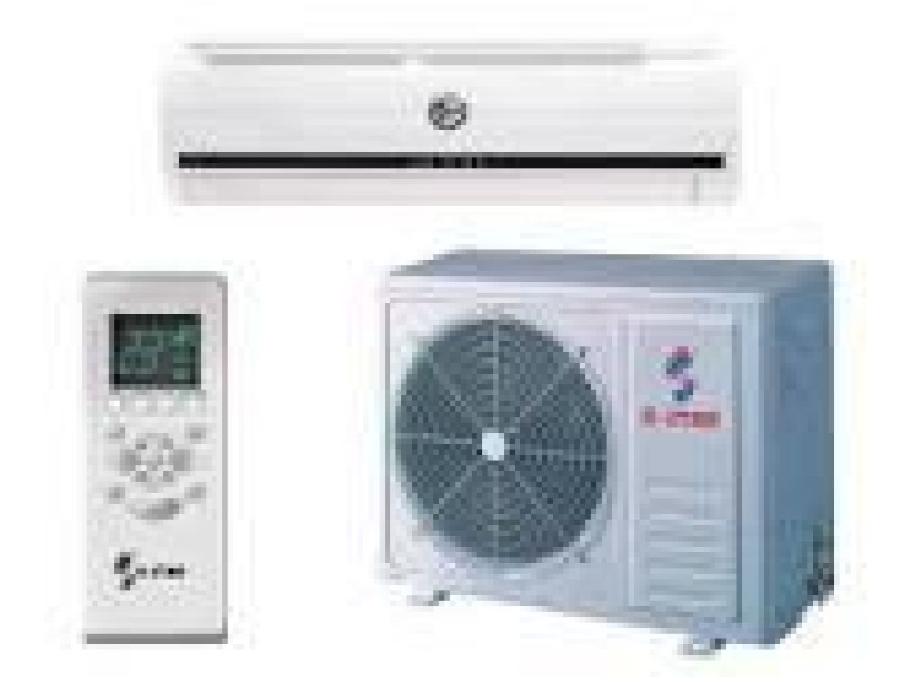
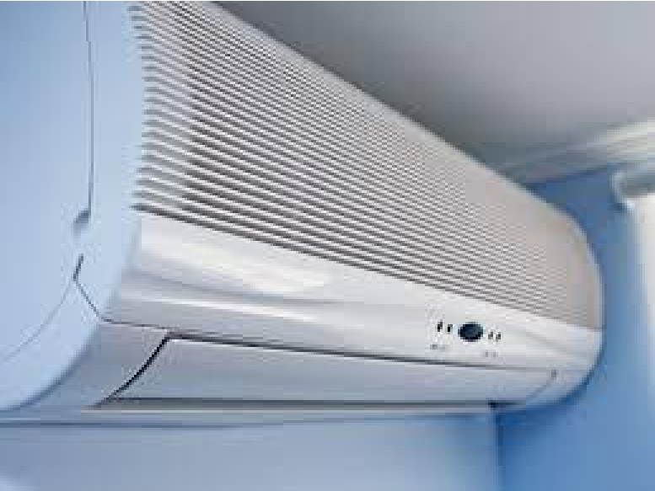
Heating, Ventilation and Air Conditioning (HVAC)
Air conditioning units monitor and maintain the temperature, air distribution and humidity in a computer room.
An Air conditioning unit is a device used for cooling and controlling the humidity and purity of the air circulating in a space.

Slide 35
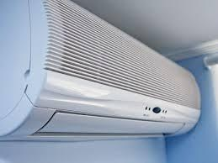
Heating, Ventilation and Air Conditioning (HVAC)
Have good air circulation in the computer room since users and computers emit heat energy.
This is possible through having enough ventilation points like windows, installing an air conditioning system.
Avoid overcrowding of machines and users.
All the above prevent suffocation and overheating.

Slide 36
Heating, Ventilation and Air Conditioning (HVAC)
Avoid direct sunlight and high Temperatures that may damage hardware components.
Ventilation should be good. Good aeration enables the computer to cool and hence avoids overheating
Dump Control: Humidity must be regulated in the computer laboratory to remain at an optimum 50%.
Low humidity may cause static electricity to build and damage sensitive components.
High Humidity of over 70% may cause rusting of the metallic parts of the computer system.

Slide 37

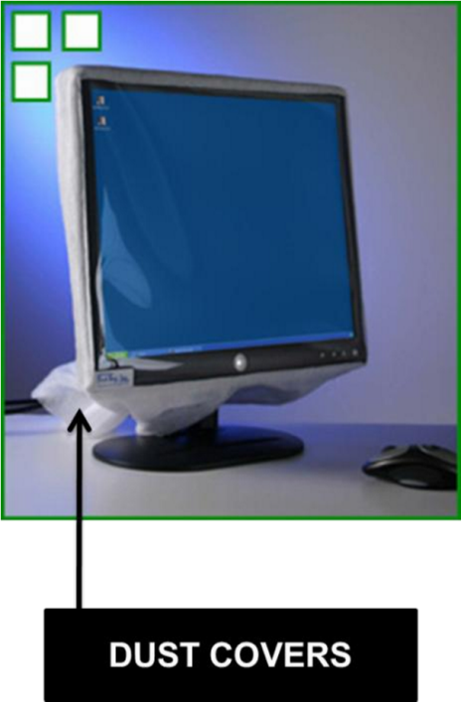
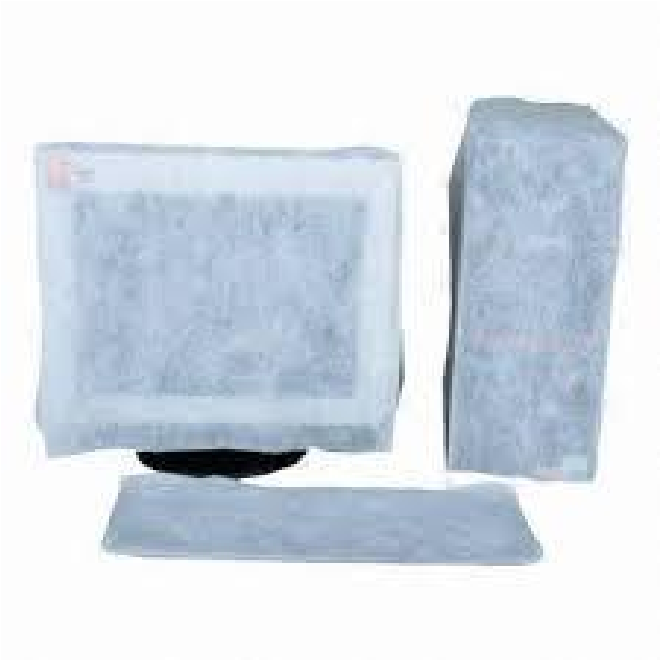
Dust Control
Blower: Used to blow/remove dust that may have entered inside the computer
Dust and Water proof covers Protect computers from moisture, water and liquids.
When setting up the computer laboratory, consider a location away from excessive dust.
The room should have special curtains and computers should remain covered using dust covers when not in use.

Slide 38
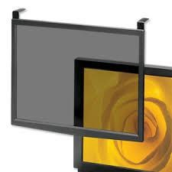
Antiglare filter screens
This is used to avoid eye strain and fatigue caused by over bright CRT monitor
Reduces electromagnetic rays from the CRT monitor
Radiation filter screens should be fitted to reduce the light that reaches the eye.

Slide 39
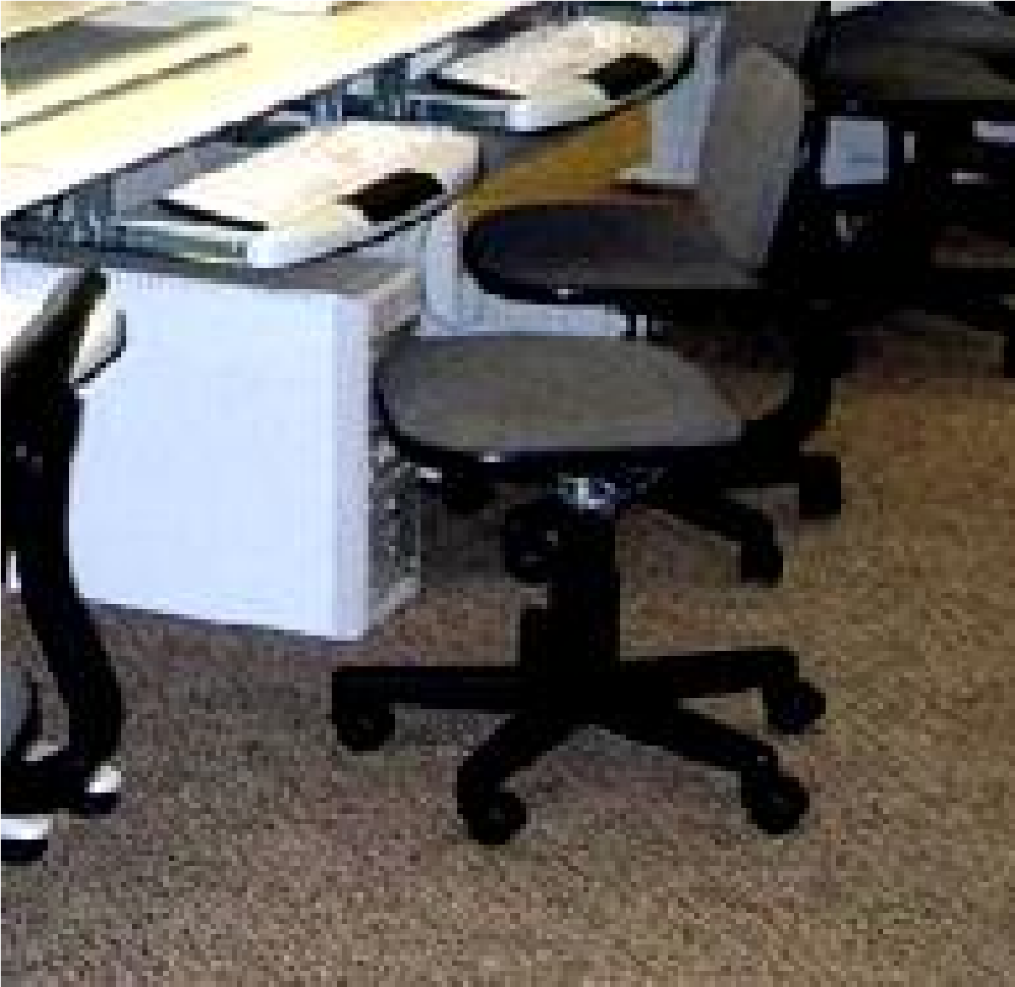
Wool carpet
Absorbs dust
Reduces effects on damage when light objects fall
Minimizes effects of electric shocks
Absorbs electrical radiations from computer devices.

Slide 40
Software security measures
Computers should have updated antivirus software installed to prevent malware.
Remote administration software should be considered with high number of computers in a computer center.
Computer management software to monitor and limit web browsing should be installed for.
Group policy or security software to prevent malicious software from being executed and installed.
Assigning unique authorised log-in for authentication before granting network access.

Slide 41
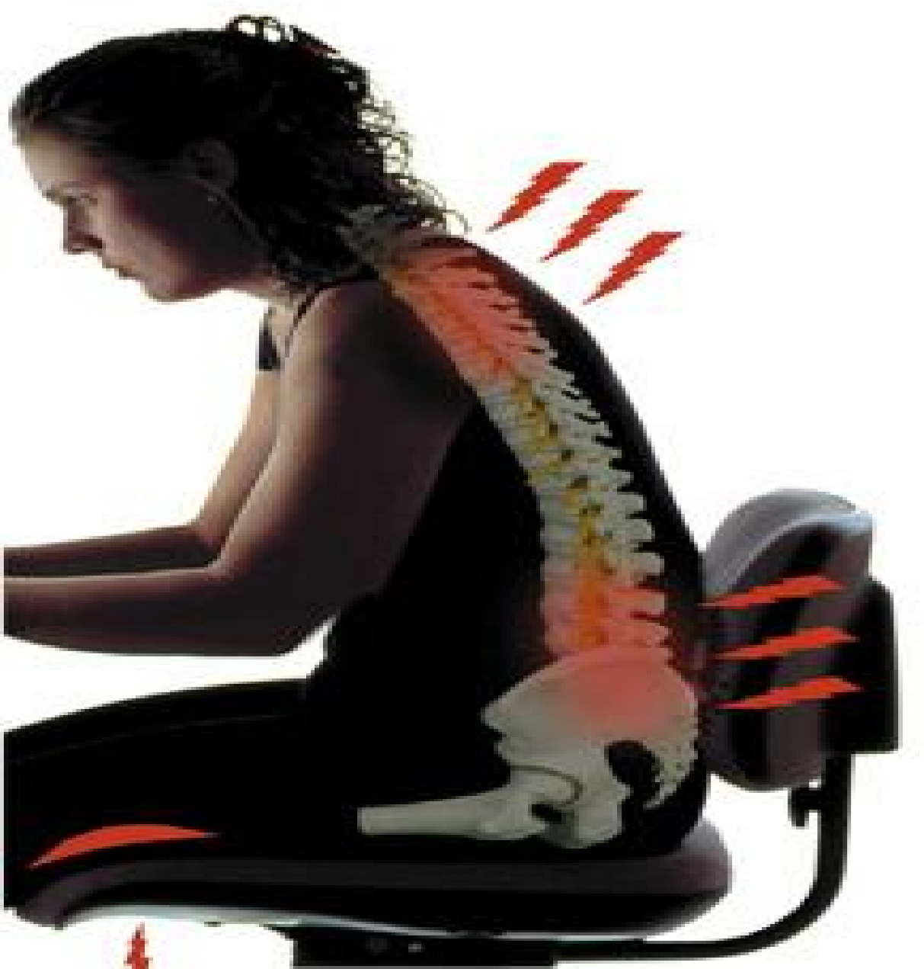
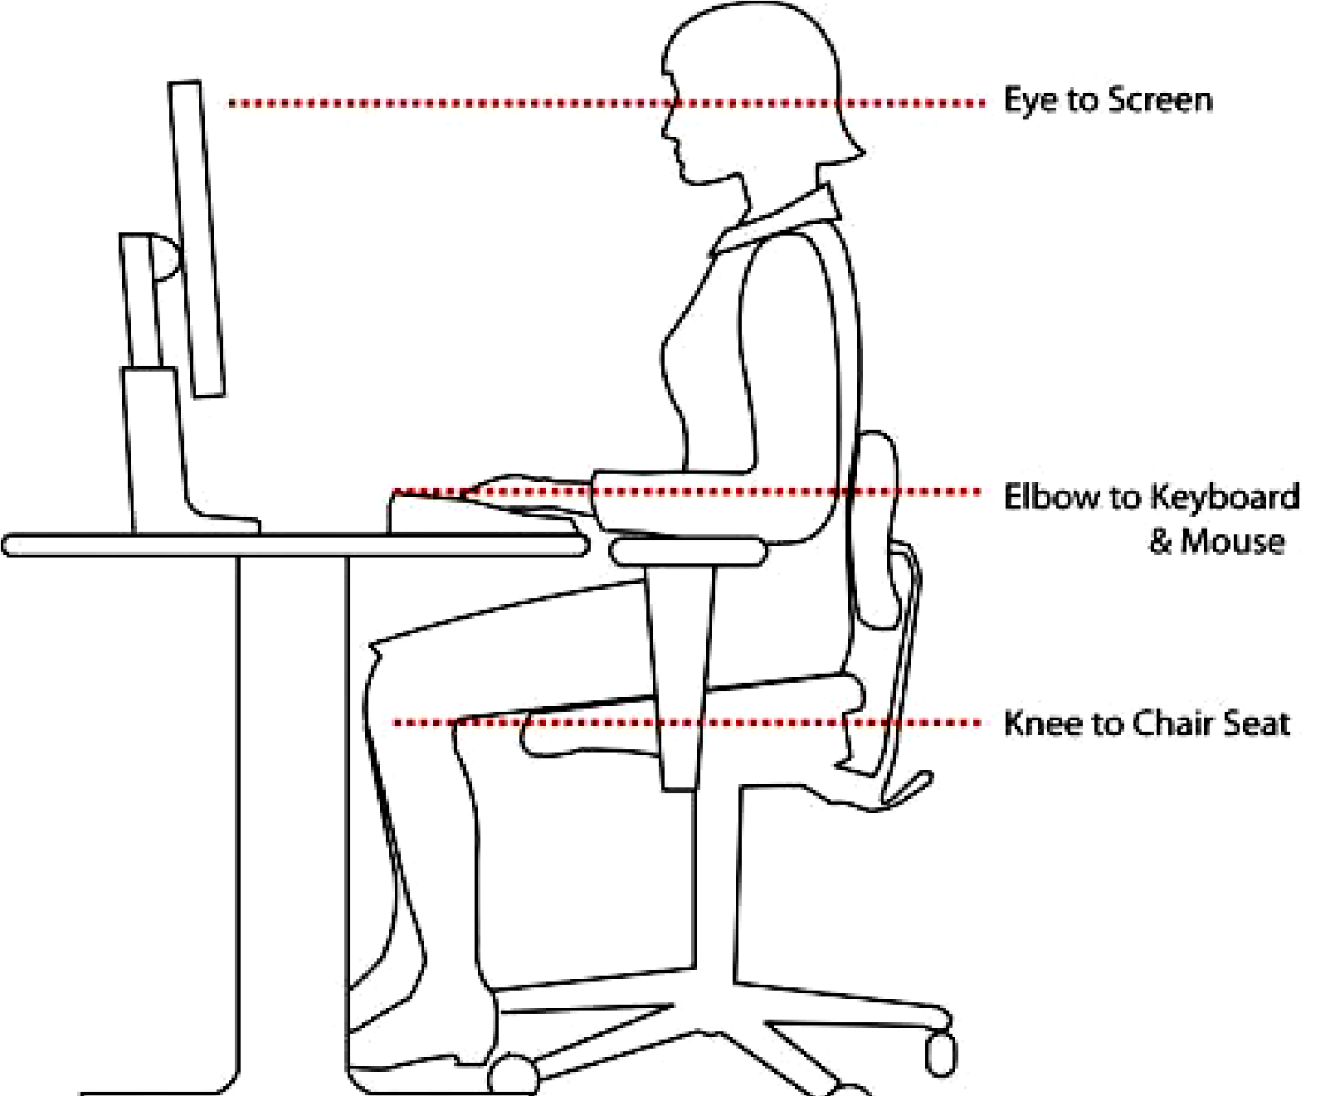

3.2.2 Safe use of the computer laboratory.
Always Sit upright: to avoid muscle pains and back aches caused by poor sitting posture.

Slide 42
3.2.2 Safe use of the computer laboratory
A computer room should have enough light avoid eyestrain, and headaches.
Standard furniture: Have standard furniture so that the tables are wide enough and strong to bear the weight of the computers and accommodate all peripherals.
The seat for the user must be comfortable and have a straight backrest that allows someone to sit upright.

Slide 43
3.2.3 Laboratory rules and regulations
Preparing Laboratory rules and regulations is very essential like other security measures, because it is aimed at guiding the users on how to use the laboratory.
Organisations usually draw the laboratory rules and regulations in line with the ICT policies passed by management.
Below are some general rules and regulations aimed at safety of computer systems, data and the users.

Slide 44
3.2.3 Laboratory rules and regulations
Avoid smoking and exposing computers to dust since they contain small abrasive particles that can damage computer components and cause wearing of moving parts.
Avoid carrying food and beverages to the computer room since these may fall into moving parts causing rusting or electrical faults.
Avoid unnecessary movements because you may accidentally knock down peripheral devices.
At all times follow the right procedures while starting and shutting down the computer therefore abrupt switching on and off the computer should be avoided since this can lead to damaging the computer.

Slide 45
3.2.3 Laboratory rules and regulations
Do not open up the metallic covers of computers or peripherals without permission and particularly when the computer power is still on.
Any repairs to the computer should be done by someone who has knowledge regarding computer repairs.
Any connections (keyboard, mouse, printer and monitor) to the computer should be done when the computer power has been switched off.
Computers should be regularly serviced and keep a regular record of computer servicing and repair to establish maintenance costs and common problems to your computer.
Guard your computer against new users who might spoil the computer and data corruption by unauthorized parties.

Slide 46
3.2.3 Laboratory rules and regulations
Cover the computers after using them or when not in use. Let the computers cool down before being covered to avoid trapping heat.
The computers should be cleaned on a regular basis to remove dust from the keyboard, mouse and other parts.
Keep computers away from excessive dust and fit special curtains that would reduce entry of dust particles and computers should not be exposed to direct sunshine.

Slide 47
3.2.3 Laboratory rules and regulations
Cover the computers after using them or when not in use. Let the computers cool down before being covered to avoid trapping heat.
The computers should be cleaned on a regular basis to remove dust from the keyboard, mouse and other parts.
Keep computers away from excessive dust and fit special curtains that would reduce entry of dust particles and computers should not be exposed to direct sunshine.

Slide 48
3.2.3 Laboratory rules and regulations
Computer components should be kept dust-free. Avoid smoking and exposing computers to dust.
Never try to remove the cover on your computer or touch inside the system unit. There are many sensitive components. Instead, take it to a qualified technician.
Keep all liquids and food items away from your computer.
Liquids and food crumbs can cause rusting and corrosion and damage electronic circuits. Also, mixing liquids and electronic components can cause serious electrical shock!
Never use your computer during a storm. The computer is connected to electricity and that means that lightning could be conducted to the computer.

Slide 49
3.2.3 Laboratory rules and regulations
Physically, be careful, avoid knocking and dropping any hardware to the ground as this could cause any of the delicate components to break or be damaged.
Proper shut down of computers should be followed to avoid disk and system failure (avoid abrupt switching off)
Be careful when using the internet. Do not accept downloads from websites that you don't know and trust.
And never open an email attachment unless you know and trust the person who sent it.
Avoid making hardware connections to the motherboard when the computer is on. Eg keyboard, monitor and mouse connections.

Slide 50
3.2.3 Laboratory rules and regulations
Don’t bring magnetic devices to the lab. The computer has magnetic disks which can be spoilt if they come near other magnetic fields
Handle delicate storage devices with care. Don’t touch the inner surface of Compact disks and Floppy disks. Safely remove Flash disks from the system.
Avoid excessively bright and flickering computer monitors. The brightness of the computer monitors should be adjusted to avoid eye strain.

Slide 51
Sub Topic 3.3: Servicing and Maintenance of Computer Systems
Sub topic Objectives:
3.3.1 Importance of servicing and maintaining a computer
3.3.2 Cleaning of computers
3.3.3 Installing and uninstalling system and application software
3.3.4 Updating and Upgrading of softwares
3.3.5 Troubleshooting on computers
3.3.6 Fine-tuning the system

Slide 52
3.3.1 Importance of servicing and maintaining a computer
Like a vehicle, a computer requires regular maintenance. When a computer stops working because of the lack of maintenance, it can be more costly to repair than regular maintenance. If you want to get the most out of your computer, you need to perform some regular maintenance for the following reasons:
Early Detection of Issues: Having regular maintenance check done on your computer can eradicate small issues before they become big problems like disk failure.
Prevention against Viruses and Malware: Regular maintenance can also help you ensure your antivirus software is up-to-date and working properly and keep both viruses and malware away.

Slide 53
3.3.1 Importance of servicing and maintaining a computer
Speeding up Computer performance: Computer maintenance involves optimization checks that can pinpoint issues and keep your computer running at an optimal speed.
Maximizing Software Efficiency for Productivity: Maintenance on your computer involves having all software up to date and running perfectly.
Preventing Data Loss: However, keeping your computer maintained will lessen the likelihood of system / disk failure instances and keep your data safe and secure for when you need to access it.
Extending computer Life: Maintaining hardware helps to extend the computer's lifespan. It helps to prevent wear and tear, and keeps the system functioning smoothly.

Slide 54
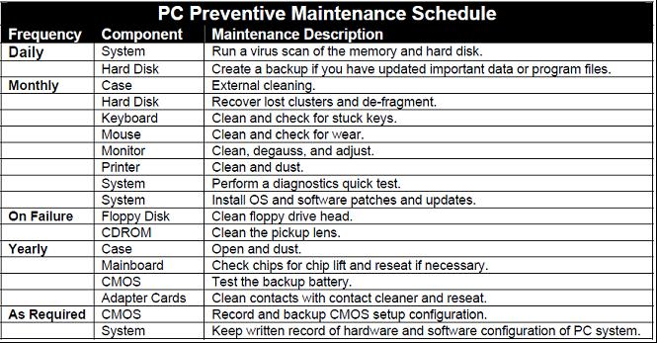
3.3.1 Importance of servicing and maintaining a computer
Sample preventive maintenance schedule

Slide 55
3.3.1 Importance of servicing and maintaining a computer
General practices for maintaining computers in good working conditions:
Regular servicing should be done for hardware and software updates to ensure proper working conditions of the computers
Computers require special cleaning even on the outside including hardware parts such as the mouse and keyboard to perform correctly.
Always use optimizer utilities that modify programs to make computers to improve performance and make them to run more quickly.
Always use and regularly updated antivirus software. Viruses and worms are horrible computer-unfriendly programs that can crash your system and cause damage.
Avoid Installation Marathons (Installing many new programs at the same time). It is therefore advisable to use the computer long enough to see how your system responds to the installation before installing the next program, to avoid conflicts.

Slide 56
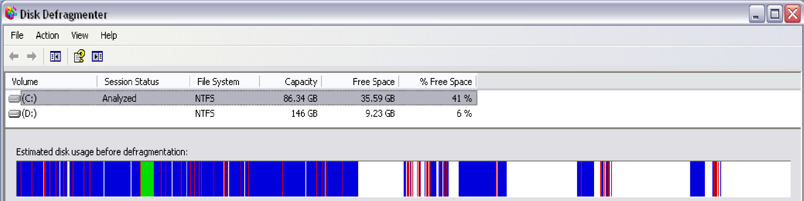
3.3.1 Importance of servicing and maintaining a computer
Carry out Disk Defragmentation when necessary. Disk Defragmentation is the process in which scattered pieces of individual files and free space are reorganized and stored in an adjacent manner (next to each other) on the disk.
Defragmentation consolidates fragmented files which makes it easy to access and process them.

Slide 57
3.3.2 Cleaning of computers
Dust and debris are the PC's worst enemy. As dust builds up, caking your fans and components, the PC finds it harder and harder to aerate and stay cool. This puts an increased strain on the hardware, leading to a shorter lifespan. Regular cleaning can significantly increase the lifespan of the computer.
This involves:
Cleaning the Case
Cleaning the Keyboard
Cleaning the Mouse
Cleaning the Monitor, etc

Slide 58
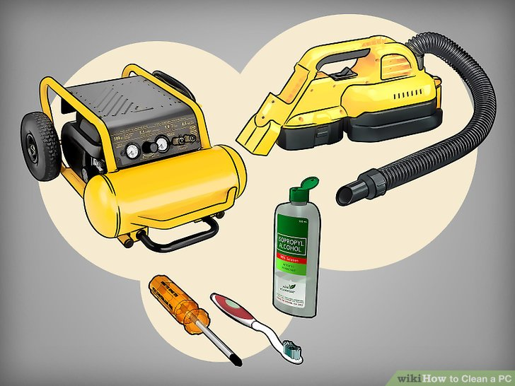
Cleaning the Case
1.Gather your supplies. You will need a screwdriver, compressed air (either in a can or via a blower), a small vacuum cleaner / blower that can fit in narrow crevices, a toothbrush, and 99% isopropyl alcohol liquid

Slide 59
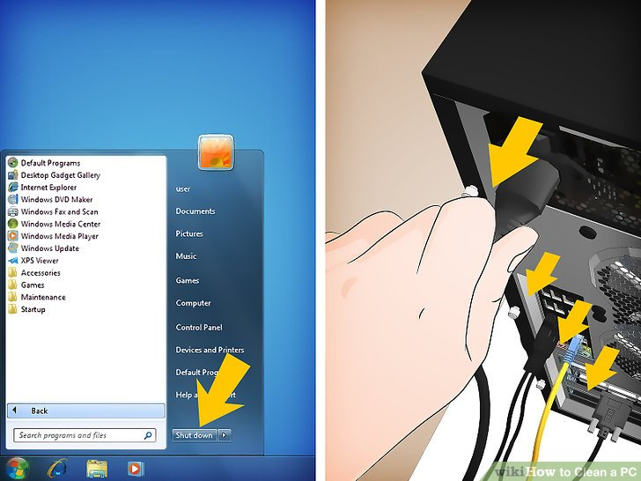
Cleaning the Case
2. Power down the computer and unplug all of the peripherals

Slide 60
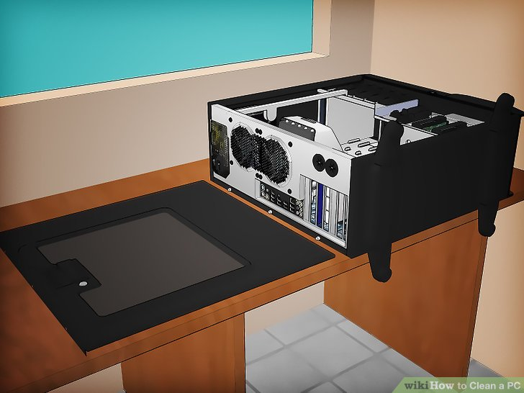
Cleaning the Case
3. Setup an area where you can blow dust.
A workbench near the window is a good choice.
Unscrew and open the case side panel.
NB: Set the screws aside so that you don't lose them.

Slide 61
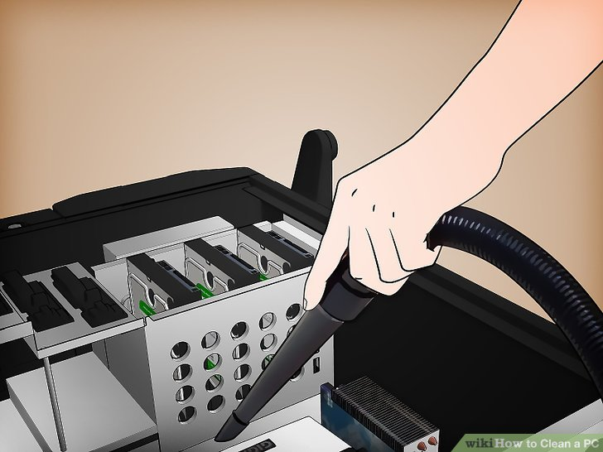
Cleaning the Case
5. Do an initial vacuum cleaning to suck up the large bits of dust from the components.
Be careful not to strike any of the fragile components with the vacuum cleaner tip as you move it across the interior.

Slide 62
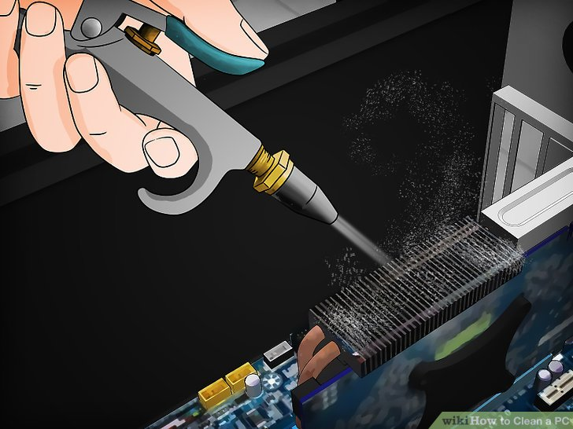
Cleaning the Case
6. Use the compressed air to blow dust out of crevices. Take your can of compressed air or air compressor and blow out the hard to reach crevices.

Slide 63
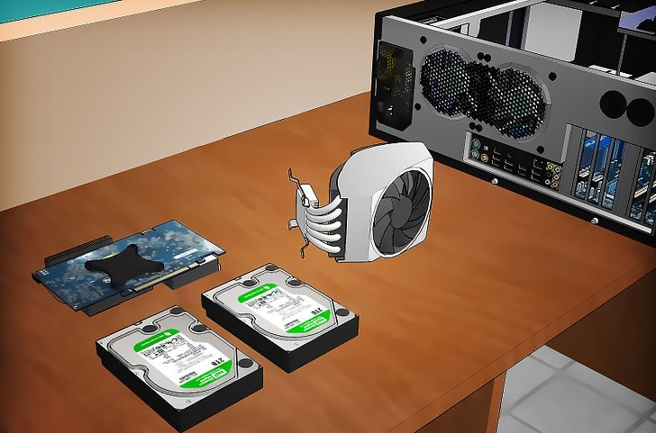
Cleaning the Case
7. You may remove some components for deep cleaning.
Removing the hard drive and any optical drives or cards can make it easier to clean them, since they are often tucked away in hard-to-reach bays. Make sure that you are properly grounded before touching any of the internal components
Removing the CPU cooler will allow you to clean out the cracks in the heat sink, as well as brush the dust out of the fans. you will need to apply a new layer of thermal paste to the CPU before reattaching it.

Slide 64
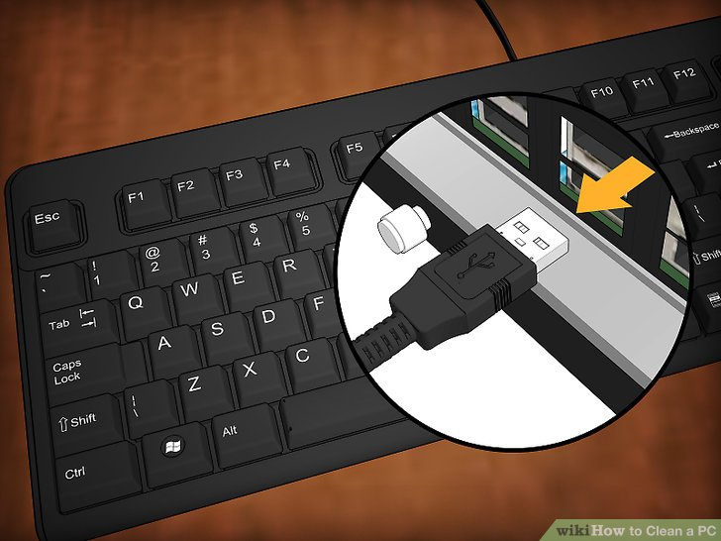
Cleaning the Keyboard
1.Unplug the keyboard.
Even if you're just planning on running a vacuum cleaner / blower over the keyboard, unplugging your keyboard first is probably a good idea.
This will help reduce the chance of electrostatic discharge damage.

Slide 65
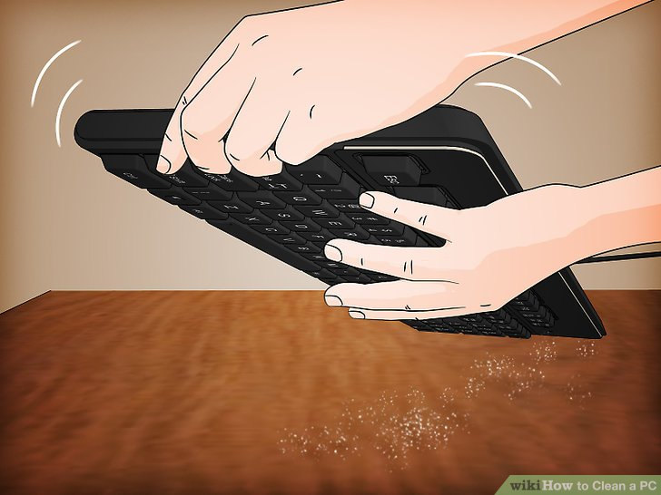
Cleaning the Keyboard
2. Shake the keyboard upside down. Hold your keyboard upside down over a surface that's easy to clean or that you don't care about (such as outside). Run your hand over the keys while holding the keyboard upside down and shake it while you do so.

Slide 66
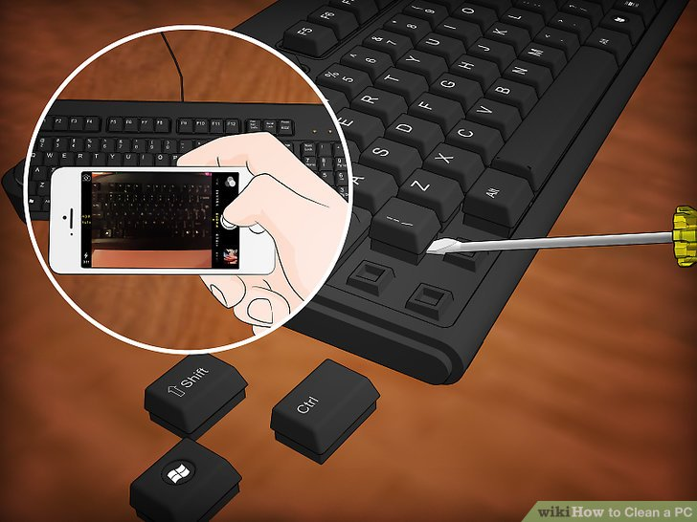
Cleaning the Keyboard
3. If you want to do a deep clean on your keyboard, you'll need to remove each of the keys so that they can be cleaned and you can access the innards of the keyboard. Removing keys is a little tedious, but can save you from needing to replace your keyboard when it gets bad / hard to press.
Take a photo of your keyboard before removing the keys so that you have an easy reference for where they're supposed to go back to. Insert a flat object such as a flathead screwdriver under they key you want to remove. Gently pry the key up until it pops off.

Slide 67
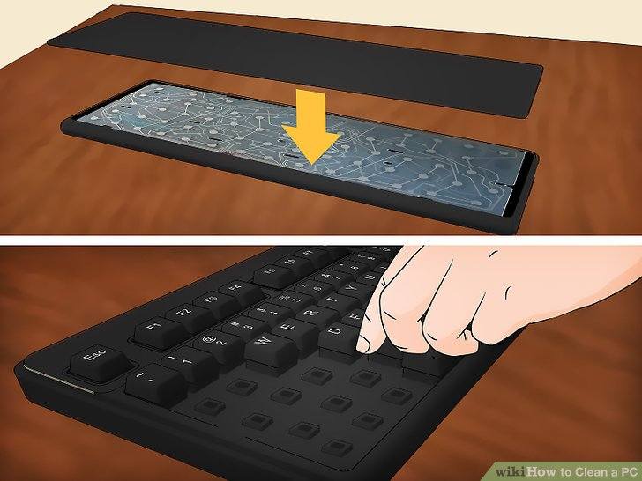
Cleaning the Keyboard
4. Reassemble the keyboard. Once everything has been washed and been given plenty of time to dry, you can put everything back together. Rebuild your keyboard, ensuring that all of the components go back together the same way the came apart. Refer to the picture of your keyboard when reattaching the keys.
You can reattach the keys by simply pressing them directly into their spot on the keyboard. Make sure that everything is completely dry and cool before putting everything back together. Any moisture can ruin the keyboard when it is plugged back in.

Slide 68
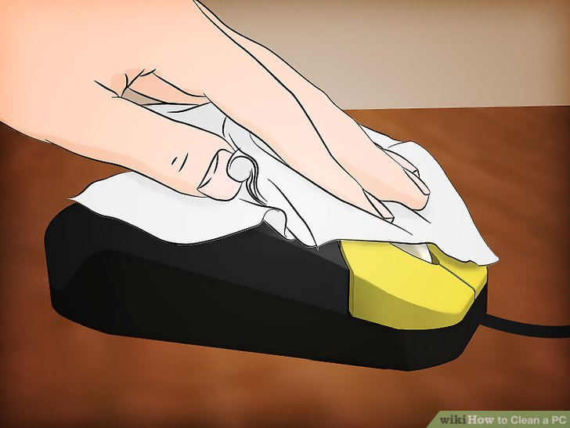
Cleaning the Mouse
1. Clean the buttons. Use a cloth or brush dipped in rubbing alcohol and gently scrub the buttons. Use a toothpick to run through the crevices between buttons and lift out the debris inside. Wipe down all the surfaces that get touched or rubbed during use

Slide 69
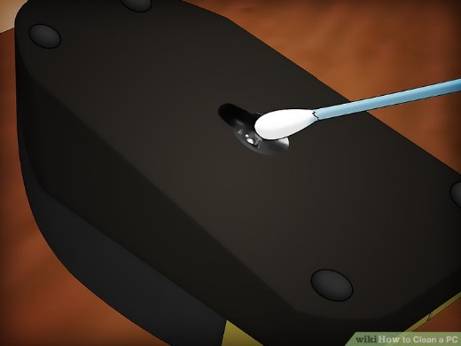
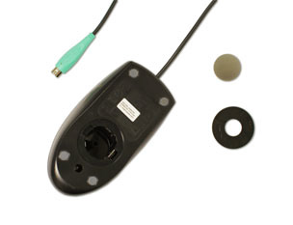
Cleaning the Mouse
Clean the lens. Turn the mouse over and look at the lens underneath. Blow any excess debris off with compressed air, and then run a cotton swab dipped in rubbing alcohol around the lens to remove stuck dust.
If you have a mechanical mouse, remove the tracking ball by turning the ball-cover ring counter-clockwise. Then clean the tracking ball and the inside of the mouse with a cotton cloth moistened with rubbing alcohol. If you are connecting it to a PS/2 port, you will need to connect it before turning on the computer.

Slide 70

Cleaning the Mouse
Clean your mousepad. Depending on your pad, you may have accumulated a fine layer of dust and debris on the surface of the mousepad itself. Most mouse pads are safe to run through the dishwasher, though your can hand wash them as well.

Slide 71

Cleaning the Monitor
Power down the monitor. Make sure that the monitor is unplugged disconnected from the computer. This will help prevent any static buildup.

Slide 72

Cleaning the Monitor
First Dust with a dry cloth. Use a microfiber or other soft cloth to very gently dust the screen. Do not pick at anything or try to scrub away debris. Simply run the cloth back and forth across the screen to pick up the dust. Don't use paper towels, toilet paper, or facial tissue as these are usually rough and could damage the screen.

Slide 73
Cleaning the Monitor
Make a cleaning solution. You can purchase specialized cleaning solutions, but you can quickly and cheaply make one at home by mixing distilled water and white vinegar in a 50/50 solution. Dab or spray this onto your cloth, and then gently run the cloth across the screen.
Never spray cleaning solution directly onto the screen, as this could seep inside and damage the components. Avoid cleaning solutions with ammonia, like Windex, or ethyl alcohol.

Slide 74
3.3.3 Installing and uninstalling system and application software
How to install system software
System software is the set of software programs that helps run the computer and coordinates instructions between application software and hardware devices.
It consists of the operating system (OS), device drivers and utility programs.
Device drivers for common devices are included in the OS software, whereas other devices come with a device driver you have to install or download off the internet

Slide 75
3.3.3 Installing and uninstalling system and application software
How to install Windows 7 Operating System
Note that this is a clean format, which means that everything will be erased from your hard drive, resetting it to the factory settings.
Materials Needed:
Functioning Computer hardware well connected
CD or DVD drive
Installation discs for Operating system
Computer Device drivers

Slide 76


3.3.3 Installing and uninstalling system and application software
How to install Windows 7 Operating System (cont)
Locate your Windows 7 install disc and insert it into your drive.
Turn your machine off.
Reboot your machine and immediately start tapping F2 which will take you to the bios setting screen.
Use the arrow keys to select the boot tab and press enter.

Slide 77


3.3.3 Installing and uninstalling system and application software
Use the arrow keys to go down and arrange the first option to CD-Rom/DVD-R by pressing - and +. For more details, see How to Boot Computer from CD.
Press ESC and choose save settings and exit.
Reboot your computer with the windows 7 install disc in the drive. If you hear the disc spinning then you have done everything right up to this point.

Slide 78


3.3.3 Installing and uninstalling system and application software
Wait for the underscore symbol on the top left of your screen to start flashing.
When it says "Press any key to boot from disc..." tap any key, a loading bar with the text "Windows is loading files" above it will appear, wait for it to load.
A windows 7 screen will popup with terms and conditions from the Installation Disc. Agree to all of these.

Slide 79


3.3.3 Installing and uninstalling system and application software
Select the main hard drive of your computer and open the Drive options (advanced) text down the bottom of the installation.
Unplug all external hard drives from the USB ports. It's possible to make the mistake of erasing your backed up files in this step.
Select format on the main hard drive of your computer. Wait about 10 seconds, congratulations you have a new hard drive!

Slide 80



3.3.3 Installing and uninstalling system and application software
Highlight your newly formatted hard drive and click install.
Wait, your computer may restart several times during this installation, this is normal.
When it is done, restart your computer to be safe.
You now have a brand new computer. Setup all the files to the way you are used to.

Slide 81

3.3.3 Installing and uninstalling system and application software
Find the drivers CD that came with your computer. You can also find the drivers needed at the computer website.
Eject the Windows 7 Install disc and insert the Drivers disc.
Autorun the disc and select to install all the drivers. This may take a while but once they are completed.
You have successfully performed a full format and reinstall of a computer computer.

Slide 82
3.3.3 Installing and uninstalling system and application software
How to install application Software
A software generally refers to any type of executable code that can be launched in a computer system. Software can be developed and distributed freely (freeware) by programmers in various communities and forums, or they can be sold commercially either online or in computer stores by software companies like Microsoft, Adobe, and Sony among others.
Materials Needed:
Computer with an operating system software already installed
CD or DVD drive
Software Installation disc
Internet connection
Web browser (to download online software)

Slide 83
3.3.3 Installing and uninstalling system and application software
How to install application Software
Step 1: The first verify if the target system meets the general hardware requirements of the application, installing a software on a machine which does not meet the minimum requirements as stated by the software developer can lead to either an unsuccessful installation or failure of the program to run after installing it.
Step 2: Make sure that the version of the application you are installing corresponds to the Operating System platform running on your machine.
Step 3: Aside from the general hardware and OS version, some computer programs also have software requirements prior to installation. Double check if you need to update or upgrade your Operating System or if there is a need to download other tools or utilities.

Slide 84
3.3.3 Installing and uninstalling system and application software
How to install application Software
Step 4: Once all the initial requirements have been met, make sure that there are no unnecessary programs running before beginning the installation procedure. In some instances, applications may require that the antivirus programs be disabled. Make sure that you are installing a legitimate application before disabling your protection software.
Step 5: Software installation can be done either from the Internet (Skip to step 7) or from an installation disc provided by the software manufacturer. To install from the disc, simply open the CD or DVD drive and insert the installation disc.
Step 6: A setup wizard window should be launched. In case there is none, open the Explorer and navigate to the optical drive. Double click on either the Autorun or the Setup file. Skip to step 9.

Slide 85
3.3.3 Installing and uninstalling system and application software
How to install application Software
Step 7: For installation from the Web, launch your browser application and download the setup file to your hard drive.
Step 8: After completion of the downloading process, run the setup program to execute the setup wizard that will handle the automatic installation of the software.
Step 9: Once the wizard is running, simply follow the prompts until the installation process is completed. For novice users, accept the default values to minimize potential problems during the procedure. Step 10: After the installation procedure has been completed and the setup wizard has terminated, reboot your machine before launching the newly installed software

Slide 86
3.3.3 Installing and uninstalling system and application software
Uninstalling programs
An uninstaller is a utility that removes a program, as well as any associated entries in the system files. When you install a program, the operating system records the information it uses to run the software in the system files. The uninstaller deletes files and folders from the hard disk, as well as removes program entries from the registry.
Windows Installer is an installation and configuration service for Windows. It also ensures that already installed programs can be easily removed from the system.
Under no circumstances should you simply delete the program folder of the application to uninstall it, because this could leave numerous files and entries in the system, which could threaten the stability of the system.

Slide 87


3.3.3 Installing and uninstalling system and application software
Uninstalling programs
To uninstall an application, use the uninstall program provided by Windows 7. Start by clicking on the Windows icon.
In the right pane, click on Control Panel.
Under Programs click on the item Uninstall a program.

Slide 88


3.3.3 Installing and uninstalling system and application software
Uninstalling programs
4. Windows then lists all programs that were installed using Windows Installer. Select the program you want to uninstall by clicking on it.
5. Click at the top on Uninstall/Change.
6. In the next message box, confirm the uninstall process by clicking on Yes.

Slide 89

3.3.3 Installing and uninstalling system and application software
Uninstalling programs
Windows now starts the uninstall process. After completion you'll receive a status message, which you confirm by selecting OK.

Slide 90
3.3.4 Updating and Upgrading of softwares
Software Updates vs Upgrades
Updates in computer software are patches of code that are released in order to address certain issues or to activate specific functionalities.
While
An upgrade is the act of replacing your product with a newer, and often more superior, version or similar product.
Therefore, an update modifies your current product while an upgrade totally replaces it.
The need to release an update stems from the fact that there are certain problems that are not apparent before the product is released. The manufacturer only discovers the problems once users report and request for help.

Slide 91
3.3.4 Updating and Upgrading of softwares
Software Updates vs Upgrades
Key differences:
1. An update is a patch that is made available after the product has been released, often to solve problems or glitches, while an upgrade is the replacement of an older version of one product to a newer one. i.e Update = a new release while Upgrade = a new version.
2. When it comes to the frequency, upgrades happen a lot less often compared to updates. A necessary part of an upgrade is the addition of new features; the development of which takes time, unlike updates which are usually patches released quickly.
3. Updates are often free while an upgrade normally costs money.
4. Updates are often mandatory / critical while upgrades are optional.
Discussion Qn: What are the major advantages of keeping software solutions up to date?

Slide 92
3.3.5 Troubleshooting on computers
Troubleshooting means identifying, diagnosing and correcting hardware and software problems that may arise when operating a computer system. Troubleshooting computers can be a little frustrating and a little tricky. With so many parts and software installed, any number of things can go wrong.
There are many things that can go wrong with a computer, but the basic principle of troubleshooting computers is that always start with the simple checks. There's a tendency to assume that when something happens it's always due to a major problem, when all it could be is a loose cable or something else minor.

Slide 93
3.3.5 Troubleshooting on computers
Basic Troubleshooting Steps
Close open programs and windows you are not currently using.
Make sure all of your cords are connected properly.
Try to repeat the sequence of commands you performed before the problem occurred. See if this causes the same response by your computer.
Press the F1 key to access the Help window. You can search for a solution to your problem once the Help window appears.
If there is an error message, record the full message for future reference.
Restart your computer to see if it clears the problem. To restart your computer, open the start window and select the Restart button instead of the Log Off button.
If restarting the computer does not clear the problem, shut down the computer and then start it back up again.
If the issue is still not resolved, check the common technology issues below or call your system administrator.

Slide 94
3.3.5 Troubleshooting on computers
Troubleshooting Common Technology Issues
Issue: The printer is not working.
Check if the printer is turned on. If not, turn it on and try again.
Check if the printer has paper. If not, put paper in the paper tray and try printing again.
Check if the printer has a paper jam. If so, remove the paper, close the printer, and try printing again.
Ensure that all printer cables are properly connected.
Turn off the printer and turn on again.
Check to see if a new printer driver is needed. Do this by going to the manufacturer’s website to search for your printer model and checking for any updated driver. Seek assistance from your system administrator before installing any drivers.

Slide 95
3.3.5 Troubleshooting on computers
Troubleshooting Common Technology Issues
Issue: The computer is frozen. A program is not responding.
Push the Ctrl, Alt, and Delete keys at the same time. Then, start the Task Manager, highlight the program’s name, and hit the End Task button.
Perform a hard reboot by simply pressing the on/off button to turn off the computer manually. This action should only be done as a last resort if you have an unresponsive program or critical error. This process could cause data loss or corruption. • Once the computer is responding again, run a virus check.

Slide 96
3.3.5 Troubleshooting on computers
Troubleshooting Common Technology Issues
Issue: The keyboard is not working.
Make sure the keyboard is connected to the computer. If not, connect it to the computer.
If you are using a wireless keyboard, try changing the batteries.
If one of the keys on your keyboard gets stuck, turn the computer off and clean with a damp cloth.
Use the mouse to restart the computer.

Slide 97
3.3.5 Troubleshooting on computers
Troubleshooting Common Technology Issues
Issue: New hardware or software is working incorrectly.
Verify your computer meets the requirements of the program or utility.
Uninstall and install the program.
There could be a conflict with another installed program and you should contact your system administrator.

Slide 98
3.3.5 Troubleshooting on computers
Troubleshooting Common Technology Issues
Issue: The mouse is not working correctly.
Check if the mouse is securely plugged into the computer. If not, plug it in completely.
Check to see if the cord has been damaged. If so, the mouse may need replacing.
If you are using a cordless mouse, try pushing the connection button on the underside of the mouse to reestablish a connection.
Clean the mouse, especially on the bottom.

Slide 99
3.3.5 Troubleshooting on computers
Troubleshooting Common Technology Issues
Issue: The computer is slow.
Free some space where necessary. There should be at least 200-500 MB of free hard drive space.:
Empty your recycle bin.
Images and videos take up a lot of space, so consider moving those to an external drive.
Remove temporary files from the Internet.
Perform a disk cleanup.
Run a virus scan to remove potential viruses that can slow down your computer.
Check and disable some background programs. You can do this by running the to run msconfig tool or the task manager.
Is RAM used up? Installing more can often help the problem.
Restart your computer.
Defragment your disks.

Slide 100
3.3.5 Troubleshooting on computers
Troubleshooting Common Technology Issues
Issue: The browser’s homepage suddenly changed.
This is a common symptom that a virus or browser hijacker may have infected the computer.
Try re-setting the home page to the default:
In Internet Explorer:
On the Tools menu, click Internet Options.
Click the General tab. In the Address box, type the Web address you want for your home page. ▪ Click OK.
In Mozilla Firefox:
Open the web site you want to set as your home page.
Click the icon to the left of the web address and drag it to the Home button. Click Yes.

Slide 101
3.3.5 Troubleshooting on computers
Troubleshooting Common Technology Issues
Issue: Problems after Installing New Software or Device Driver:
Of course you should first uninstall the software or driver. Or use System Restore to return your system to a previous working state. To open System Restore or click Start -> Programs -> Accessories -> System Tools -> System Restore.
Issue: No Power:
The main culprit is usually the power supply unit. Make sure the power cord is securely plugged into the supply and the wall outlet. If so, you can buy a tester to see whether your Power Supply Unit is receiving and putting out enough voltage.

Slide 102
3.3.5 Troubleshooting on computers
Troubleshooting Common Technology Issues
Issue: Computer fails to Boot:
Sound Codes made by a computer can help during troubleshooting:
Double beep: If the computer makes a double beep sound and starts/boots normally, then there is no hardware problem.
Prolonged beep: a continuous/ prolonged beep sound with no display means that memory is missing in the computer.
If you don't hear a beep at all, more than likely it's a failing power supply or motherboard.
CMOS BIOS errors: The CMOS RAM powered by a battery stores the BIOS program which contains hardware parameters of the computer, namely: CPU speed, RAM size, HDD size, system date, boot order etc. If/when the battery loses its charge, the contents of the CMOS RAM are lost, and BIOS errors will be displayed every time you start your computer.

Slide 103
3.3.5 Troubleshooting on computers
Troubleshooting Common Technology Issues
Common POST errors:
Keyboard Failure: displayed when BIOS does not detect a keyboard on your computer during a POST.
Incorrect system date and time.
Boot failure can be caused by
Non-system disk placed in the USB or floppy drive, or
Missing operating system or loosely connected hard disk
Issue: Time Keeps Changing:
If you constantly have to set the time/date clock, that's the main symptom of a bad CMOS battery. Replace it. But just like any other battery it has to be the same size. Look at the number on your battery and buy one with the same number.

Slide 104

3.3.5 Troubleshooting on computers
Troubleshooting Common Technology Issues
LED (light Emitting Diode) lights: Electronic devices including computers display lights of different colours to indicate hardware problems or a normal working state.
Computers of the Dell brand in particular, use LED lights to indicate different states/conditions in which the computer is operating as shown below.

Slide 105

3.3.5 Troubleshooting on computers
Troubleshooting Common Technology Issues
LED lights:

Slide 106
3.3.6 Fine-tuning the system
The operating system gets gunked up as apps are added and incompletely deleted, leaving behind drivers and all sorts of other system detritus. Eventually, our full hard drives choke the OS as it tries to run. Outdated drivers cease to work correctly.
Fine Tuning the system helps boost performance.
Using Tune-up Utilities
A PC tune-up utility is an application that digs deep into your computer and fixes trouble areas. It performs several functions, including defragmenting your PC's hard drive, repairing the incredibly problematic Windows Registry, and freeing up disk space by deleting useless and duplicate files.
Some tune-up utilities perform just those basic functions, while more elaborate ones add numerous features that improve your computer in interesting ways.

Slide 107

3.3.6 Fine-tuning the system
Using Tune-up Utilities
AVG TuneUp, for example, offers multi-platform protection with a suite that includes Android, Mac, and Windows tools.
Other examples of Tuneup / Optimiser utilities include CCleaner, Ashampoo WinOptimizer and Comodo PC Tuneup. In addition, many of these utilities automatically fetch new drivers so that your hardware runs at peak performance

Slide 108
3.3.6 Fine-tuning the system
Other measures one can do to tune-up the system include the following
Remove temporary files. Access the "Start" menu and select "All Programs." Click on "Accessories" and then "System Tools." Choose "Disk Cleanup" to scan the computer for unnecessary files that can be deleted. Select the files you would like to remove and click "Delete files."
Run Check Disk. Click the "Start" button and then select "Computer." Right-click the the drive you would like to check and then select "Properties." click the "Tools" tab and then select "Check now" to check the disk for errors. Choose "Automatically fix file system errors" and "Scan for and attempt recovery of bad sectors" from the available options to check for both file errors and physical flaws in the disk.

Slide 109
3.3.6 Fine-tuning the system
Other measures one can do to tune-up the system include the following
Using the Performance troubleshooter: Open the Performance troubleshooter by clicking the Start button The Start button , and then clicking Control Panel. In the search box, type troubleshooter, and then click Troubleshooting. Under System and Security, click Check for performance issues.
Clean up your hard disk and Delete programs you never use.
Limit how many programs run at startup. (use the msconfig tool )
Defragment your hard disk.
Restart regularly.
Add more RAM.
Change the size of virtual memory

Slide 110
Review questions
Define the term computer laboratory
Mention four factors to consider when preparing a computer laboratory.
Why must there be safety rules and precautions in a computer laboratory? List any three reasons.
List down two reasons as to why power cables in the computer laboratory need to be properly insulated.
Mention two reasons as to why computers need a stable power supply.
Suggest two ways through which good air circulation can be achieved in a computer laboratory.
Suggest two reasons why standard furniture must be provided for a computer laboratory.
Differentiate between fine-tuning and troubleshooting a computer.

Slide 111
Review questions
Mention five ways through which computers can be kept safe.
Define the following terms
a) Computer literacy (b) Disk Defragmentation
Suggest any ten rules and regulations that must be followed when in a computer laboratory.
Your school headmaster wants to setup a new computer laboratory. Explain the requirements needed to setup the laboratory.
Suggest any five factors to be considered when buying computers.
Identify any five devices used in computer laboratory maintenance and safety.
How can physical security be achieved so that access to computers and data centers is regulated?
Explain any four software security measures that can be enforced in the computer laboratory.
A computer is running too slow. Mention any five troubleshooting steps you can undertake to identify and correct the problem.

Slide 112
Subsidiary ICT for Uganda
End of Topic 3: Computer Laboratory Care and Maintenance
Next Topic 4: Computer Word Processing

